Slide 1
International Db2
Users Group
IDUG.org

Slide 2
What is IDUG?
The International Db2 Users Group (IDUG®) is the leading independent, user-driven community that provides a direct channel to thousands of professional Db2 users across the globe.

Slide 3
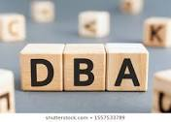
Who is IDUG for?
Developers
Database Administrators
System Programmers
Security Engineers
IT Professionals
Data Architects/Engineers
Data Scientists/Analysts
IT Architects

Slide 4
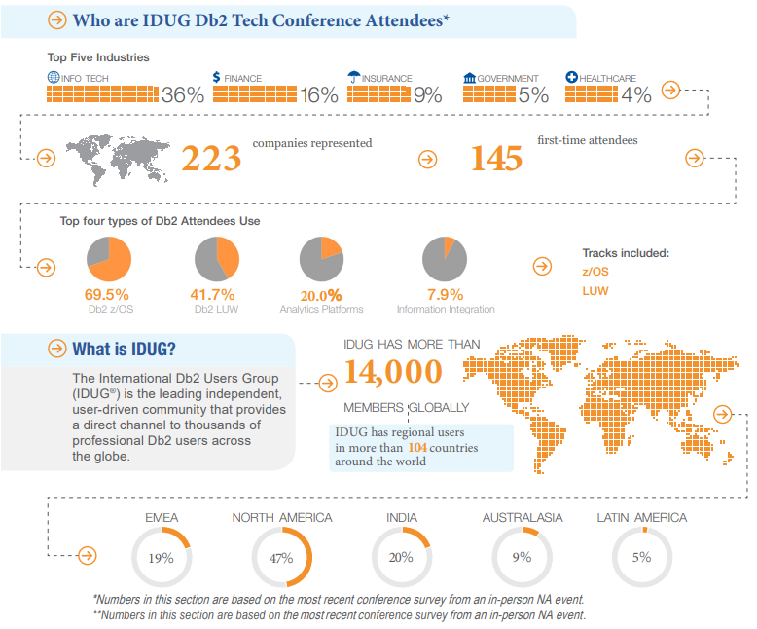
Why IDUG?
IDUG.org
30+ years technical education
Unites Db2 professionals globally
Forum (DB2-L)
Db2 Content, blogs, videos, presentations
Db2 Events
North America
Latin America
EMEA
Australia
Asia
and expanding rapidly
Db2 Certification at conferences
Supports Regional User Groups (RUGs)
Social networking communities for “like-minded” individuals

Slide 5
The Attendee Experience
100+ educational sessions with industry professionals
Discussions with industry experts in Db2
Hands-on Labs & Workshops
Back to Basics & Application Development learning paths
Complimentary Db2 certification & badging opportunities (a $200+ value)
Networking and more!
https://www.idug.org/events/calendar/north-america-conference-2022
Register now at IDUG.org

Slide 6
IDUG NA 2022 Content Showcase
AppDev
Db2 Testing Options Dan Luksetich, DanL Database Consulting
Things Your DBAs Hear... and how to stop making them crazy! Craig Mullins, Mullins Consulting, Inc.
Are you happy or are you still deprecated? Roy Boxwell, Software Engineering GmbH
A Handful of Application Development Goodies in Db2 12 Emil Kotrc, Broadcom
Back to Basics: Optimizer Access Paths and Performance Tony Andrews, Themis Inc.
z/OS
Db2 for z/OS Utilities - Best Practices Haakon Roberts, IBM
Indexes, the First Performance Tool Jim Dee, BMC
2022 Edition + Db2 13 - Db2 for z/OS Development "SWAT Tales" Anthony Ciabattoni, IBM
Db2 for z/OS and z16 Synergy Akiko Hoshikawa, IBM
Db2 for z/OS User Transformation Strategy Update Sowmya Kameswaran, IBM
LUW
Db2 Roadmap - A Peak Ahead Keri Romanufa, IBM
My Favourite Db2 Problem Determination Tricks IBM
Making Magic with Db2 and Jupyter Notebooks George Baklarz, IBM
Running Db2 PureScale in a public cloud Dale McInnis, IBM

Slide 7
IDUG & IBM Champions
>30% speakers are IBM Champions
Stuart & Libby presenting in person:
What it takes to be an IBM Champion
Champion social networking at IDUG
Adrian Collett Emil Kotrc Mark Gillis
Bob Bersano Ferdinand Prahst Michael Tiefenbacher
Brian Laube Fred Sobotka Mohankumar Saraswatipura
Chris Crone Gareth Copplestone-Jones Paul Turpin
Chris Muncan Greg DeBo Roland Schock
Christoph Theisen Ian Bjorhovde Roy Boxwell
Craig Mullins Jim Dee Saghi Amirsoleymani
Daniel Luksetich Joe Geller SMike Toppins
Dave Beulke Jørn Thyssen Toine Michielse
David Simpson Ken Shaffer Tom Glaser
Ember Crooks Libby Ingrassia Tony Andrews

Slide 8
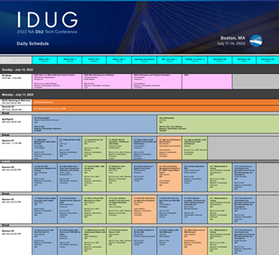
IDUG North America 2022
More information at IDUG.org
In-person & Virtual Conference Experience
Registration is Open Now!
https://www.idug.org/idug22nadb2techconference/registration
Presentations & Presenters
https://www.idug.org/idug22nadb2techconference/content/technicalsessions
Conference Schedule
https://www.idug.org/idug22nadb2techconference/daily-schedule-grid-idug

Slide 9
The Attendee Experience
100+ Technical Breakout Sessions occurring over all 4 days
Network with Vendor Partners in the Solution Center on Sunday – Tuesday
Optional Workshops offered Saturday and Wednesday
Db2 Fundamentals Track for z/OS at IDUG EMEA22 (different registration/fee & schedule*)
Db2 Fundamentals Track for LUW at IDUG EMEA22 (different registration/fee & schedule*)
Virtual offering of EMEA22 education (~ 33% of onsite content)
https://www.idug.org/events/calendar/2022-emea-conference

Slide 10
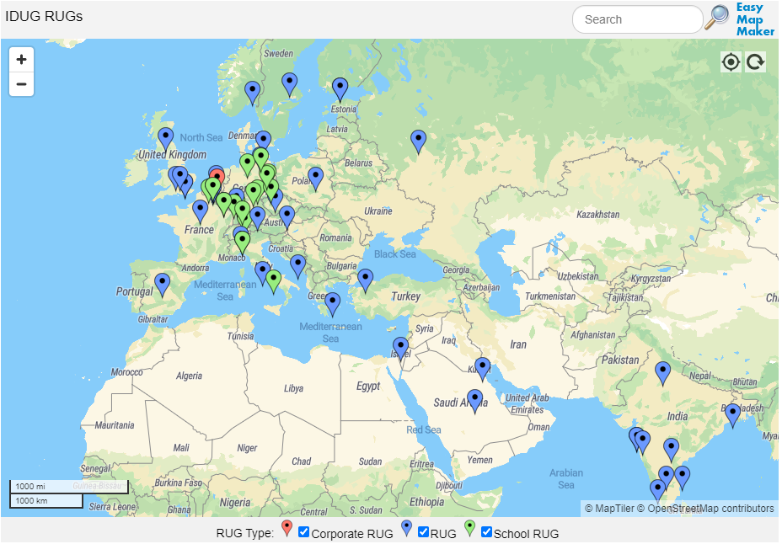
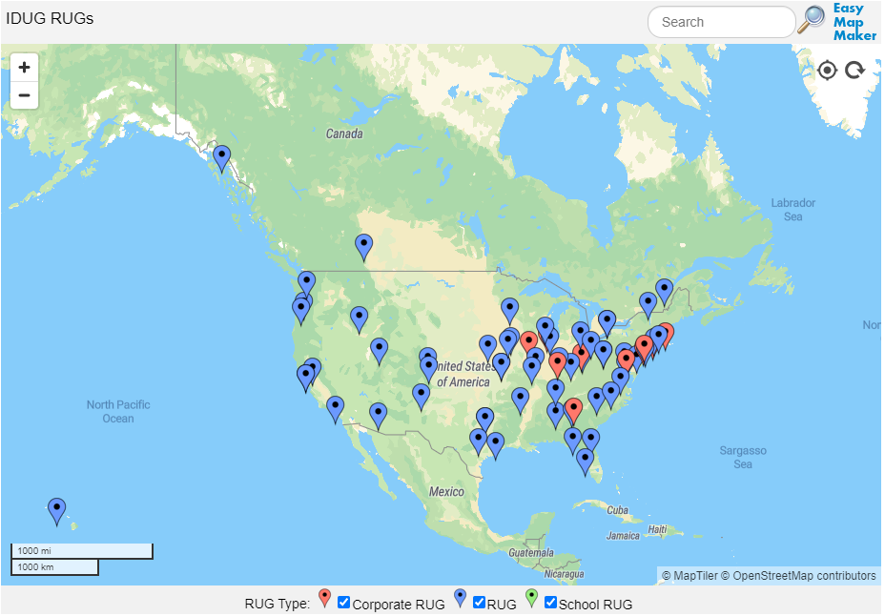
Regional User Groups
https://www.idug.org/higherlogic/s/page/user-groups-home

Slide 11
IDUG RUG Committee Organization
IDUG RUG Committee Chair
Željen Stanić
IDUG RUG Committee Regional Members
North America Dustin Ratliff , Chris Muncan
EMEA Jan Tielemans, Adrian Collett
Latin America Javier Estrada Benavides
Asia open
Australia/New Zealand open
BoD Liaison
Mateja Jankovič
Vendor (BoD) Liaisons
IBM Jim Reed
BMC William Moran
Broadcom Jasminder Singh

Slide 12
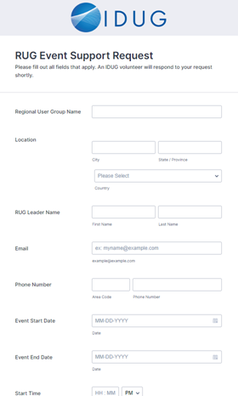
IDUG RUG Support
Created form for RUG support :
https://form.jotform.com/idug/rug-event-support-request

Slide 13
Thank You

