Slide 1

Taming Python
for Db2 for z/OS
Midwest RUGs
Jørn Thyssen, Rocket Software
2022 IBM Champion

Slide 2
Agenda
Objectives:
Install the ibm_db python library on z/OS
Write your python programs on z/OS connecting to Db2 for z/OS
Introduction
  About Python
  Python and databases
    The DB-API
    Installing ibm_db on z/OS
Python program examples
  REST, stored procedures, excel
  Db2 queries, Db2 commands, Db2 utilities, Visual Explain, Explain tables, accelerator management, …
  General z/OS: datasets, jobs, …
More details on python and ibm-db:
https://www.youtube.com/watch?v=Dhc0dg2dPic

Slide 3


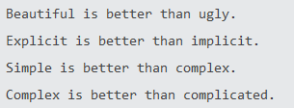
What is python
Interpreted programming language
First released in 1991 by Guido van Rossum
Designed to be simple (See “The Zen of Python”)

Slide 4
Why Python
Python continuously ranks in the top 3 over popular programming languages
  TIOBE (May 2022): #1, overtaking C
  PYPL (May 2022): #1, almost 2x Java
  Jobs available: #3 behind C and SQL
It is widely taught at educational institutions
If you’re my age or younger you’ve probably been exposed to Python
  I learned it at university in the mid-1990s

Slide 5
Why Python, cont’ed
Widely used in
  Machine Learning
  Data Science
  Infrastructure provisioning
    Ansible
  Scientific computing
  Web sites
    Google, Instagram, Spotify, Netflix, Dropbox, Uber, …

Slide 6
Typical use cases for Python on z/OS
REXX has much better z/OS support
Python has many modules, easy to code, more people knows python, …
Productivity aid programs; internal services
  Replacement for REXX for “young” programmers
Pipelines, automated testing, ..
Ansible (infrastructure provisioning)
Machine learning and analytics
Reporting

Slide 7
Get python for z/OS
Order IBM Open Enterprise SDK for Python from IBM ShopZ (optional support available)
or
Download PAX https://www.ibm.com/products/open-enterprise-python-zos/details
or
Rocket OpenApp Dev for z
  https://www.rocketsoftware.com/openappdev-for-z
  Conda install or SMP/E (with support)
  Includes IBM Python
  Also includes git and many other open source tools for application developers

Slide 8
Python and databases
Python DB-API v2.0 specification
“Identical” code to access databases across all platforms & database vendors
Python_ibmdb project
  Maintained by Db2 Connect development team
  Uses ODBC drivers
ibm_db: python drivers for IBM Db2
ibm_db_dbi: implementation of the DB-API v2.0 specification
You get both then you install ibm_db
Source code: https://github.com/ibmdb/python-ibmdb
API doc: https://github.com/ibmdb/python-ibmdb/wiki/APIs
Blog by John Maenpaa: https://www.idug.org/blogs/john-maenpaa1/2021/01/22/db2-python-programing-hdbc-vs-hdbi

Slide 9
ibm_db – distributed platform
On distributed platform:
  Uses Db2 Connect CLI drivers (IBM Data Server Driver)
  Connect to Db2 for z/OS using DRDA
  Need Db2 Connect for z/OS license to connect to Db2 for z/OS
Python
LUW
ibm_db
ODBC
IBM Data Server Driver
Db2 for z/OS
DRDA
Db2 Connect
License required

Slide 10
ibm_db – installing on distributed platform
pip install ibm_db
Installs ibm_db and ODBC drivers
  If you already have Db2 Connect CLI drivers on your machine:
  set IBM_DB_HOME=c:/path/to/clidriver
  set LIB = %IBM_DB_HOME%/lib;%LIB%
A Db2 Connect license is required to connect to Db2 for z/OS
  Enterprise Edition:
    get license file (something.lic) from IBM Passport Advantage
    Copy to license folder in %IBM_DB_HOME%
  Unlimited Enterprise Edition
    Activate license on z/OS side with db2connectactivate.bat
Recommended!

Slide 11
ibm_db – z/OS
On z/OS:
  CAF (Call Attachment Facility)
  RRSAF (Resource Recovery Services attachment Facility)
  Default plan DSNACLI
  Bind ODBC plans & packages: HLQ.SDSNSAMP(DSNTIJCL)
  No additional licenses required !
Python
USS
ibm_db
ODBC
Db2 for z/OS
Db2 for z/OS
CAF or RRSAF
FMID JDBCC17
“DB2 ODBC”

Slide 12
Installing ibm_db on z/OS
No pre-compiled binaries available like distributed platform
Pip3 install ibm_db will
  Download source
  Compile ibm_db C modules (IBM z/OS C/C++ compilers required)
  Install into your site-packages library
Important prereqs:
  IBM Python V3.8.3+ (from IBM or Rocket z Open App Dev )
  Db2 V12 PTF UI72859: Python related bugfixes for ODBC driver
  No PTFs required for Db2 V13
More details here: https://github.com/ibmdb/python-ibmdb/blob/master/install.md

Slide 13
Installing ibm_db on z/OS
Python should be available in your path
  Unless you’re a sysprog you’ll likely not have authority to create the site-package so consider using a python virtual environment
Set required environment variables for install/compilation
  Code page auto conversion
  IBM_DB_HOME is the HLQ for your Db2 libraries (SDSNMACS, SDSNC.H)
python3 –m venv $HOME/ibm_python_env
source $HOME/ibm_python_env/bin/activate
export _BPXK_AUTOCVT='ON'
export _CEE_RUNOPTS='FILETAG(AUTOCVT,AUTOTAG) POSIX(ON) XPLINK(ON) '
export IBM_DB_HOME=RSRTE.DSN.VC10

Slide 14
Installing ibm_db on z/OS, cont’ed
Run the install
(ibm_python_env) bash-4.3$ pip3 install ibm_db --no-build-isolation
Collecting ibm_db
Using cached ibm_db-3.1.1.tar.gz (1.1 MB)
Preparing wheel metadata ... done
Building wheels for collected packages: ibm-db
Building wheel for ibm-db (PEP 517) ... done
Created wheel for ibm-db: filename=ibm_db-3.1.1-cp38-cp38-os390_27_00_8561.whl size=379062 sha256=bdecf22c8ca33ea7a9eb82f33f05a569861c4495a85c46fe21124f4d819d34ea
Stored in directory: /u/ts5941/.cache/pip/wheels/79/ca/5a/0aa8ee4ff812a4d3b02f09150732219e5fccbf03a84005b99c
Successfully built ibm-db
Installing collected packages: ibm-db
Successfully installed ibm-db-3.1.1
(ibm_python_env) bash-4.3$ chtag -r $HOME/ibm_python_env/lib/python3.8/site-packages/ibm_db.so
Note: requires C compiler!

Slide 15
First ibm_db program
Set STEPLIB so Python can find the ODBC Db2 z/OS drivers
Create an ODBC ini file
Set environment variable DSNAOINI to point to the ODBC ini file
(ibm_python_env) $ export STEPLIB=PDS1.SDSNEXIT:HLQ.SDSNLOD2:HLQ.SDSNLOAD
(ibm_python_env) $ export DSNAOINI=="$HOME/ODBC_PDS1_CAF"
ODBC_PDS1_CAF file:
[COMMON]
MVSDEFAULTSSID=RS01PDS1
FLOAT=IEEE
CURRENTAPPENSCH=ASCII
APPLTRACE=0
APPLTRACEFILENAME=/u/xxxxx/odbc_trace
[RS01PDS1]
AUTOCOMMIT=1
MVSATTACHTYPE=CAF
PLANNAME=DSNACLI
https://www.ibm.com/support/knowledgecenter/SSEPEK_12.0.0/odbc/src/tpc/db2z_hdckeyw.html
Name of ODBC ini file is arbitrary
With lots of SSIDs I just prefer to have SSID in the name

Slide 16
First ibm_db program, cont’ed
Simple program using ibm_db
import ibm_db
conn=ibm_db.connect('','','')
if conn:
sql = "SELECT * FROM SYSIBM.SYSTABLES FETCH FIRST 10 ROWS ONLY"
stmt = ibm_db.exec_immediate(conn, sql)
result = ibm_db.fetch_both(stmt)
while( result ):
print(result[1].strip()+"."+result[0].strip())
result = ibm_db.fetch_both(stmt)
ibm_db.close(conn)

Slide 17
First ibm_db program, cont’ed
(ibm_python_env) $ python3 simple-test.py
SYSIBM.DBDR
SYSIBM.IPLIST
SYSIBM.IPNAMES
SYSIBM.LOCATIONS
SYSIBM.LULIST
SYSIBM.LUMODES
SYSIBM.LUNAMES
SYSIBM.MODESELECT
SYSIBM.SCTR
SYSIBM.SPTR

Slide 18
Ok, what if I am running on distributed platform?
The code is the same! – except for the connect
On distributed platform you must provide user ID/password as it is not using local attach
import ibm_db
conn=ibm_db.connect('DSN=RS01PDS1;uid=xxxxx;pwd=yyyyyy','','')

Slide 19
Bonus slide: what about SSL?
Of course!
I haven’t configured an ODBC entry for my SSL connection,
so I’ll use the alternate connection string syntax
import ibm_db
conn=ibm_db.connect('database=RS01PDS1;hostname=rs01.rocketsoftware.com;port=3713;protocol=tcpip;uid=xxxx;pwd=yyyy;security=ssl;sslServerCertificate=c:\\users\\jthyssen\\documents\\certificates\\pds1.ca.cert','','')
Pds1.ca.cert is the CA certificate in .CER (BASE64) format

Slide 20
Second ibm_db program
Vendor program writes log file in USS
I need program that extract interesting part of log file and insert into Db2 table for further analysis
Log entry is partial text and partial JSON
[2020.10.05 10:53:58.844][INFO] : IZPSC0003I - Request received: {"userName":"xx
xxxx","requestId":"b66a02df-58ac-4408-a353-9cdc1ace661a","httpMethod":"GET","pat
h":"/ws/security/users/current-user","isSecure":true,"clientIP":"137.134.4.54","
requestParams":{},"requestHeaders":{"referer":["https://rs01.rocketsoftware.com:
8644/ZLUX/plugins/org.zowe.zlux.bootstrap/web/"],"cookie":["jedHTTPSession=Dm0c+
S6XAjTqJAxalEWlJJdW5BWvDBKOdokXeW3t4EZeZBR9/vdFxw=="],"accept-language":["en-US,
en;q=0.5"],"host":["rs01.rocketsoftware.com:12023"],"connection":["keep-alive"],
"accept-encoding":["gzip, deflate, br"],"user-agent":["Mozilla/5.0 (Windows NT 1
0.0; Win64; x64; rv:81.0) Gecko/20100101 Firefox/81.0"],"accept":["application/j
son"]}}

Slide 21
Second ibm_db program, cont’ed
if len(sys.argv) < 3:
print("Usage: %s <DSN name> <IZP log file name>" % (sys.argv[0]))
exit(-1)
filepath=sys.argv[2]
dsn='DSN='+sys.argv[1]
print("Extracting REST calls from file: %s" % (filepath) )
print("Inserting into table IZP.IZPLOG on %s" % (dsn) )
conn=ibm_db.connect(dsn,'','')
if conn:
print("Succesfully connected to %s" %(dsn) )
else:
print("Connection to %s failed" % (dsn) )
exit

Slide 22
Second ibm_db program, cont’ed
with open(filepath,'r') as fp:
line = fp.readline()
if debug:
print(line)
reccnt = 0
reqcnt = 0
rspcnt = 0
while line:
reccnt += 1
if line.find("IZPSC0003I") > 0:
log_request(conn,line)
reqcnt += 1
elif line.find("IZPSC0004I") > 0:
log_response(conn,line)
rspcnt += 1

Slide 23
Second ibm_db program, cont’ed
def log_request(conn,line):
timestamp=line[1:line.find("]")]
start_json=line.find("{",line.find("IZPSC0003I"))
req=json.loads(line[start_json:])
sql = "MERGE INTO IZP.IZPLOG L "
"USING( "
"VALUES ( "
" '" + str(req["requestId"]) + "' "
" ,'" + str(req["userName"]) + "' "
" ,TIMESTAMP_FORMAT('" + timestamp + "','YYYY.MM.DD HH24:MI.SS.FF3') "
" ,'" + str(req["httpMethod"]) + "' "
" ,'" + str(req["path"]) + "' "
[code snipped]
" ,REQUESTPARAMS = N.REQUESTPARAMS "
if debug:
print(sql)
stmt = ibm_db.exec_immediate(conn, sql)
return

Slide 24
Second ibm_db program, cont’ed
Run program from USS command line
(test2) $ python izp-log.py RS01PDS1 izp-server-2020-10-05_11-53.08.log
Extracting REST calls from file: izp-server-2020-10-05_11-53.08.log
Inserting into table IZP.IZPLOG on DSN=RS01PDS1
Successfully connected to DSN=RS01PDS1
1000 records processed (23 REST reqs, 22 REST resps)
2000 records processed (142 REST reqs, 141 REST resps)
…
48000 records processed (4507 REST reqs, 4503 REST resps)
49000 records processed (4602 REST reqs, 4598 REST resps)
50000 records processed (4686 REST reqs, 4686 REST resps)
Number of log records analyzed : 50535
Number of REST requests found : 4686
Number of REST responses found : 4686
I declare I have won!

Slide 25
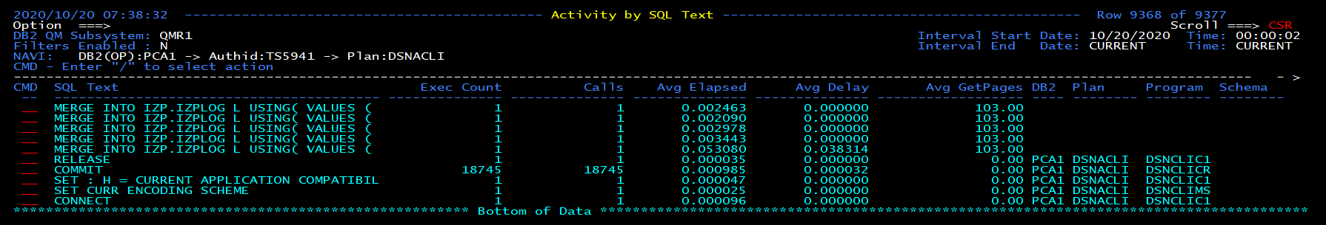
Second ibm_db program, cont’ed
Output from monitor
MERGE statement repeated 9372 times with different literals
18745 COMMITS
Note: PLAN = DSNACLI

Slide 26
Second ibm_db program, iteration #2
My DBA will not be happy ☹
Must do:
  Need to use host variables
  Better commit strategy
Stretch goal: Cache prepare

Slide 27
Host variables & cache prepare
if not stmt1:
sql = "MERGE INTO IZP.IZPLOG L "
"USING( "
"VALUES ( ?, ?, TIMESTAMP_FORMAT(?,'YYYY.MM.DD HH24:MI.SS.FF3'), ?, "
" ?, ?, ?, ?)) "
[code snipped]
" ,REQUESTPARAMS = N.REQUESTPARAMS "
if debug:
print(sql)
stmt1 = ibm_db.prepare(conn, sql)
ibm_db.bind_param(stmt1, 1, str(req["requestId"]))
ibm_db.bind_param(stmt1, 2, str(req["userName"]))
[code snipped]
ibm_db.bind_param(stmt1, 8, str(req["requestParams"]))
ibm_db.execute(stmt1)

Slide 28
Auto commit
Disable auto commit
  Modify ODBC INI file
    AUTOCOMMIT=0
  In code
Add explicit commits
Remember: must commit before disconnect !
ibm_db.autocommit(ibm_db.SQL_AUTOCOMMIT_OFF)
ibm_db.commit(conn)

Slide 29
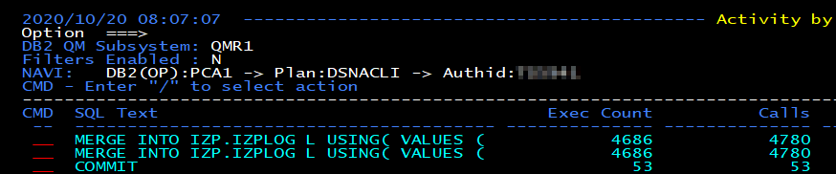
Second ibm_db program, iteration #2, cont’ed
Output from monitor
Only two different statements
Only 53 commits
… oh BTW, program is significantly faster now ☺

Slide 30


Error handling
try:
ibm_db. prepare(conn, sql)
except:
print("log_request PREPARE MERGE failed: ",ibm_db.stmt_errormsg())
Python has “try … except … else”
ibm_db.conn_errormsg() – connection error message
ibm_db.stmt_error() – SQLSTATE (integer)
ibm_db.stmt_errormsg() – SQLCA (string, formatted)
log_request PREPARE MERGE failed: {DB2 FOR OS/390}{ODBC DRIVER}{DSN12015} DSNT408I SQLCODE = -440, ERROR: NO AUTHORIZED FUNCTION NAMED XIMESTAMP_FORMAT HAVING COMPATIBLE ARGUMENTS WAS FOUND DSNT418I SQLSTATE = 42884 SQLSTATE RETURN CODE DSNT415I SQLERRP = DSNXORFN SQL PROCEDURE DETECTING ERROR DSNT416I SQLERRD = -100 0 0 -1 0 0 SQL DIAGNOSTIC INFORMATION DSNT416I SQLERRD = X'FFFFFF9C' X'00000000' X'00000000' X'FFFFFFFF' X'00000000' X'00000000' SQL DIAGNOSTIC INFORMATION ERRLOC=5:10:2 SQLCODE=-440
https://www.ibm.com/support/knowledgecenter/SSEPGG_11.5.0/com.ibm.swg.im.dbclient.python.doc/doc/c0054395.html

Slide 31
Calling a stored procedure
Issue a REORG from a python program
Call SYSPROC.DSNUTILU / SYSPROC.DSNUTILV
ibm_db.callproc – call procedure
ibm_db.fetch_assoc – fetch row from result set
ibm_db.next_result – next result set

Slide 32
Calling a stored procedure, cont’ed
utility_id = 'REORGDEF'
restart = 'NO'
utstmt = 'TEMPLATE FCOPY DSN RSTEST.IC.&SSID..&SN..P&PA..&UNIQ. UNIT 3390 TEMPLATE REC1 DSN &USERID..&SSID..UNLD.&DB..&TS. UNI
T 3390 DISP(OLD,CATLG,CATLG) TEMPLATE WORK1 DSN &USERID..&SSID..SYSUT1 UNIT 3390 TEMPLATE WORK2 DSN &USERID..&SSID..SORTOUT U
NIT 3390 REORG TABLESPACE TS5941.GLWSDPT LOG NO SORTDATA SHRLEVEL CHANGE KEEPDICTIONARY STATISTICS TABLE(ALL) SAMPLE 60 INDEX(
ALL) COPYDDN(FCOPY) UNLDDN(REC1), WORKDDN(WORK1,WORK2)'
retcode = 0
stmt, utility_id,restart,utstmt,retcode = \
ibm_db.callproc(conn, 'SYSPROC.DSNUTILU', (utility_id,restart,utstmt,retcode) )

Slide 33
Calling a stored procedure, cont’ed
while stmt1:
# result set available
row = ibm_db.fetch_assoc(stmt1)
while row:
print(row[“TEXT”])
row = ibm_db.fetch_assoc(stmt1)
stmt1 = ibm_db.next_result(stmt)

Slide 34
Calling a stored procedure, cont’ed
(test2) $ python call-sp.py RS01PDS1 TS5941.GLWSDPT
Running REORG for tablespace TS5941.GLWSDPT on DSN=RS01PDS1
Successfully connected to DSN=RS01PDS1
1DSNU000I 297 11:43:16.65 DSNUGUTC - OUTPUT START FOR UTILITY, UTILID = REORGDEF
DSNU1045I 297 11:43:16.66 DSNUGTIS - PROCESSING SYSIN AS UNICODE UTF-8
0DSNU050I 297 11:43:16.66 DSNUGUTC - TEMPLATE FCOPY DSN RSTEST.IC.&SSID..&SN..P&PA..&UNIQ. UNIT 3390
DSNU1035I 297 11:43:16.67 DSNUJTDR - TEMPLATE STATEMENT PROCESSED SUCCESSFULLY
[snip]
DSNU610I !PCA1 297 11:43:18.33 DSNUSUCD - SYSCOLDIST CATALOG UPDATE FOR TS5941.GLWXDPT2 SUCCESSFUL
DSNU620I !PCA1 297 11:43:18.33 DSNUSEOF - RUNSTATS CATALOG TIMESTAMP = 2020-10-23-11.43.17.393547
DSNU3357I 297 11:43:18.71 DSNUGUTC - MAXIMUM SORT AMOUNT ESTIMATION VARIATION WAS 0 PERCENT
DSNU3355I 297 11:43:18.71 DSNUGUTC - TOTAL SORT MEMORY BELOW THE BAR: OPTIMAL 24 MB, USED 24 MB
DSNU010I 297 11:43:18.73 DSNUGBAC - UTILITY EXECUTION COMPLETE, HIGHEST RETURN CODE=4

Slide 35
Calling a stored procedure – ADMIN_COMMAND_DB2
Issue command on DSN=RS01PDS1: -DISPLAY GROUP
Succesfully connected to DSN=RS01PDS1
Result set
DSN7100I !PCA1 DSN7GCMD
*** BEGIN DISPLAY OF GROUP(PDS1 ) CATALOG LEVEL(V12R1M509)
CURRENT FUNCTION LEVEL(V12R1M510)
HIGHEST ACTIVATED FUNCTION LEVEL(V12R1M510)
HIGHEST POSSIBLE FUNCTION LEVEL(V12R1M510)
PROTOCOL LEVEL(2)
GROUP ATTACH NAME(PDS1)
---------------------------------------------------------------------
DB2 SUB DB2 SYSTEM IRLM
MEMBER ID SYS CMDPREF STATUS LVL NAME SUBSYS IRLMPROC
-------- --- ---- -------- -------- ------ -------- ---- --------
PCA1 1 PCA1 !PCA1 ACTIVE 121510 RS01 IR05 PCA1IRLM
PCB1 2 PCB1 !PCB1 QUIESCED 121510 RS02 IR06 PCB1IRLM
---------------------------------------------------------------------
SCA STRUCTURE SIZE: 16384 KB, STATUS= AC, SCA IN USE: 7 %
LOCK1 STRUCTURE SIZE: 64512 KB
NUMBER LOCK ENTRIES: 16777216
NUMBER LIST ENTRIES: 36345, LIST ENTRIES IN USE: 15
SPT01 INLINE LENGTH: 32138
*** END DISPLAY OF GROUP(PDS1 )
DSN9022I !PCA1 DSN7GCMD 'DISPLAY GROUP ' NORMAL COMPLETION
python3 disgroup.py
Issue command: -DISPLAY GROUP
Successfully connected to Db2
Member Status Version LPAR
PCA1 ACTIVE 121510 RS01
PCB1 QUIESCED 121510 RS02

Slide 36
Python and all the libraries
Big advantage of python is 1000s of libraries
  Many work out-of-the-box
  Some require porting of C-code (like ibm_db)
Interesting libraries – my personal list:
  ibm_db – of course ☺
  Requests – for making REST calls
  Flask – for making web apps
  Jupyter / pandas / matplotlib
  XLSX – for creating Excel spreadsheets

Slide 37
Calling a Db2 native REST service
<Response [200]>
{'TESTIDC4': {'serviceName': 'TESTIDC4', 'serviceCollectionID': 'TS5941', 'version': 'V1', 'isDefaultVersion': True, 'serviceProvider': 'db2service-1.0', 'serviceDescription': 'TEST IDENTICALLY NAMED COLUMNS 4', 'alternateServiceURL': 'https://rs01.rocketsoftware.com:3713/services/TS5941/TESTIDC4', 'serviceURL': 'https://rs01.rocketsoftware.com:3713/services/TS5941/TESTIDC4/V1', 'serviceStatus': 'started', 'RequestSchema': {}, 'ResponseSchema': {'$schema': 'http://json-schema.org/draft-04/schema#', 'type': 'object', 'properties': {'ResultSet Output': {'type': 'array', 'items': {'type': 'object', 'properties': {'CREATOR': {'type': 'string', 'maxLength': 128, 'description': 'VARCHAR(128)'}, 'NAME': {'type': 'string', 'maxLength': 128, 'description': 'VARCHAR(128)'}}, 'required': ['CREATOR', 'NAME', 'NAME'], 'description': 'ResultSet Row'}}, 'StatusDescription': {'type': 'string', 'description': 'Service invocation status description'}, 'StatusCode': {'type': 'integer', 'multipleOf': 1, 'minimum': 100, 'maximum': 600, 'description': 'Service invocation HTTP status code'}}, 'required': ['StatusDescription', 'StatusCode', 'ResultSet Output'], 'description': 'Service TESTIDC4 invocation HTTP response body'}}}
import requests
import sys
if len(sys.argv) < 3:
print("Usage: %s <userid> <password> " % (sys.argv[0]))
exit(-1)
userid=sys.argv[1]
password=sys.argv[2]
collection='TS5941'
service='TESTIDC4'
url = 'https://rs01.rocketsoftware.com:3713/services/'+collection+'/'+service
auth = requests.auth.HTTPBasicAuth(userid,password)
resp = requests.get(url,auth=auth,verify=False)
print(resp)
print(resp.json())

Slide 38
Tune a query using IBM Db2 Tuning Services
Db2 Accessories Suite for z/OS – Database Services Expansion Pack Feature (no-charge, available from IBM ShopZ)
UI available through VS Code IBM Db2 Developer Extension and web-based IBM Db2 Administration Foundation
But you can also call tuning services from a program or pipeline
This example
  Logon to Tuning Services
  Submit Runstats advisor “job” (job = async task in the Tuning Service server)
  Wait for “job” to complete
  Show result

Slide 39
Tune a query using IBM Db2 Tuning Services
#Submit Runstats advisor
url = baseUrl + '/tuningservice/v1/sa'
resp = requests.post(url,json=vebody,verify=verify,headers=headers)
job_id=resp.json()['job_id']
Logon TMS
<Response [200]>
Submit Runstats advisor
<Response [202]>
TMSJOB0002I: The job has been submitted with Job_ID 1714307214070517760.
Job ID 1714307214070517760 status RUNNING
Job ID 1714307214070517760 status COMPLETED
Runstats advisor results
<Response [200]>
Runstats recommended:
RUNSTATS TABLESPACE DSNDB06.SYSTSTAB TABLE(SYSIBM.SYSTABLES) COLUMN(ALTEREDTS,ARCHIVING_SCHEMA,ARCHIVING_TABLE,AUDITING,CARD, CHECKFLAG,CHECKRID,CLUSTERTYPE,COLCOUNT,CONTROL, CREATEDBY,CREATEDTS,CREATOR,DBID,DBNAME, …

Slide 40
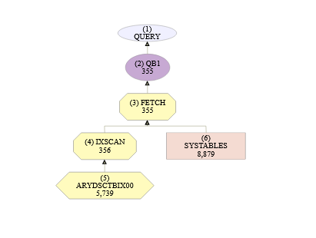
Tune a query using IBM Db2 Tuning Services
#Submit Visual Explain advisor
print("Submit Visual Explain advisor")
url = baseUrl + '/tuningservice/v1/ve'
resp = requests.post(url,json=vebody,verify=verify,headers=headers)
print(resp)
job_id=resp.json()['job_id']
Logon TMS
<Response [200]>
Submit Visual Explain advisor
<Response [202]>
TMSJOB0002I: The job has been submitted with Job_ID 1743841672647675904.
Job ID 1743841672647675904 status RUNNING
Job ID 1743841672647675904 status COMPLETED
Visual Explain advisor results
<Response [200]>
URL for Visual Explain: https://rs01.rocketsoftware.com:9944/tuningservice/v1/ve/viewer/1e7dff89-d2f1-46ad-b6f2-1412f500637e

Slide 41
Upgrade EXPLAIN tables – inspired from IDUG-L
Db2 for z/OS ships stored procedure ADMIN_EXPLAIN_MAINT to create, upgrade and create alias for explain tables
Alternatively use the Db2 Tuning Service REST endpoint
explaintbbody = {
"action": "CREATE",
"auth_id": "TS5941",
"bp16kblob": "BP16K0",
"bp32kblob": "BP32K",
"bp4kblob": "BP0",
"bp8kblob": "BP8K0",
"connection": "profile1",
"database_name": "TS5941EE",
"ixbufferpool": "BP0",
"managealias": "NO",
"mode": "RUN",
"schema_alias": "",
"schema_name": "TS5941EE",
"storagegroup": "DB2EA",
"storagegroup_idx": "DB2EA",
"tableset": "ALL",
"ts16kbufferpool": "BP16K0",
"ts32kbufferpool": "BP32K",
"ts4kbufferpool": "BP0",
"ts8kbufferpool": "BP8K0"
}
url = baseUrl + '/tuningservice/v1/explaintb'
resp = requests.post(url,json=explaintbbody,verify=verify,headers=headers)
Logon TMS
<Response [200]>
Run Explain table maintenance
<Response [200]>
{'code': 200, 'status': 'success', 'payload': {'result': [{'ALIAS_CREATED': '0', 'TB_NOT_UNICODE': '0', 'TB_EXAMINED': '0', 'TS_DROPPED': '0', 'AUX_CREATED': '5', 'TB_DROPPED': '0', 'TB_CREATED': '23', 'DB_CREATED': '1', 'TB_ALTERED': '0', 'IX_CREATED': '26', 'TS_CREATED': '28’, …

Slide 42
Manage Db2 Analytics Accelerator
Uses IBM Db2 Analytics Accelerator Administration Services
  Available from IBM Fix Central https://ibm.biz/BdfWns
UI available through web-based IBM Db2 Administration Foundation
But you can also call tuning services from a program or pipeline
This example
  Logon to Accelerator Admin Services
  Load a table

Slide 43
Load table in Db2 Analytics Accelerator
# Generate JWT auth token
print("Logon Accel Admin Svc")
url = baseUrl + '/token'
resp = requests.post(url,json=loginbody,verify=verify)
print(resp)
token=resp.json()['result']['token']
#print(token)
headers={'Authorization':'Bearer '+token}
print(f"Load table {schema}.{table}")
url = baseUrl + '/table/partition/load'
resp = requests.post(url,json=loadbody,verify=verify,headers=headers)
print(resp)
print(resp.json())
Logon Accel Admin Svc
<Response [201]>
Load table TS5941.TESTMD
<Response [200]>
{'result': {'name': 'IDAAZ30'}, 'message': [], 'status': 'SUCCESS'}

Slide 44

Jupyter install on z/OS
$ conda create -n jupyter_env notebook pip xlc-wrapper cython "panda*" matplotlib matplotlib
$ conda activate jupyter_env
$ pip install ibm_db
$ jupyter notebook --generate-config
[edit config – I added my SSL cert and change port#]
$ mkdir my-notebooks
$ cd my-notesbooks
$ jupyter notebook
[I 02:31:15.307 NotebookApp] Notebook authentication will be used. The hashed password should be in the configuration file.
[I 02:31:15.977 NotebookApp] Serving notebooks from local directory: /u/userid/devel/jupyter-notebooks
[I 02:31:15.977 NotebookApp] The Jupyter Notebook is running at:
[I 02:31:15.977 NotebookApp] https://rs01.rocketsoftware.com:8888/?token=a21db5d98377c28af0527d3157ac9444e0d9688549f693dc
[I 02:31:15.977 NotebookApp] Use Control-C to stop this server and shut down all kernels (twice to skip confirmation).
[C 02:31:15.983 NotebookApp]
To access the notebook, open this file in a browser:
file:///u/userid /.local/share/jupyter/runtime/nbserver-131433-open.html
Or copy and paste one of these URLs:
https://rs01.rocketsoftware.com:8888/?token=a21db5d98377c28af0527d3157ac9444e0d9688549f693dc

Slide 45
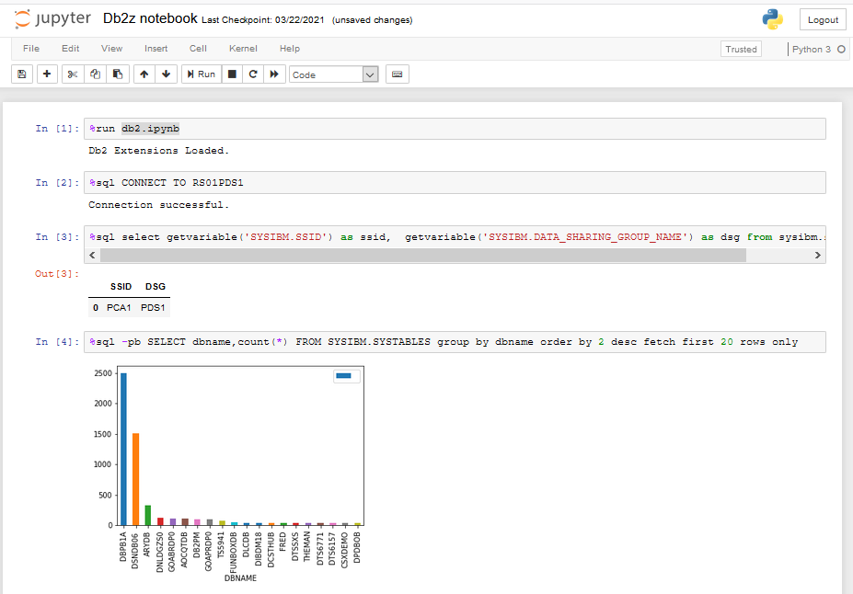
Jupyter
Get db2.ipynb from https://github.com/IBM/db2-jupyter/blob/master/db2.ipynb

Slide 46
Write excel file from Db2 query
import ibm_db
import sys
import xlsxwriter
print(ibm_db.__version__)
conn=ibm_db.connect('','','')
workbook = xlsxwriter.Workbook('simple-excel.xlsx')
worksheet = workbook.add_worksheet()
cell_format0 = workbook.add_format({'bold': True, 'font_color': 'red'})
row = 0
worksheet.write(row,0,"CREATOR",cell_format0)
worksheet.write(row,1,"NAME",cell_format0)
row = row + 1
if conn:
sql = "SELECT CREATOR,NAME FROM SYSIBM.SYSTABLES WHERE CREATOR = 'SYSIBM' AND NAME LIKE 'SYS%' FETCH FIRST 10 ROWS ONLY"
stmt = ibm_db.exec_immediate(conn, sql)
result = ibm_db.fetch_both(stmt)
while( result ):
worksheet.write(row,0,result[0].strip())
worksheet.write(row,1,result[1].strip())
row = row + 1
result = ibm_db.fetch_both(stmt)
ibm_db.commit(conn)
ibm_db.close(conn)
workbook.close()
Report generation from SQL statement
Output written as XLSX
Uses xlsxwriter library

Slide 47
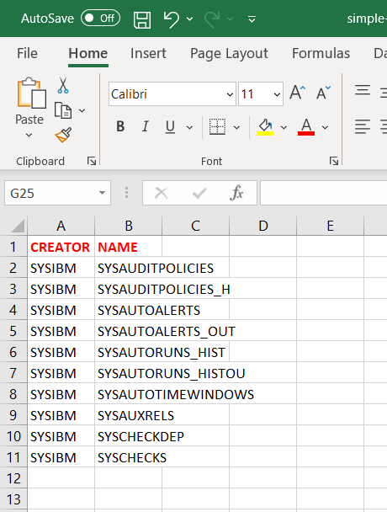
Write excel file from Db2 query
Zowe zos-files download uss-file "/u/ts5941/devel/python-samples/excel/simple-excel.xlsx" -f "simple-excel.xlsx" –b
"C:\Program Files\Microsoft Office\root\Office16\EXCEL.EXE" simple-excel.xlsx

Slide 48
Bonus topic – interact with z/OS
Datasets
Jobs
Other z/OS services
Very little native support
IBM Z Open Automation Utilities

Slide 49
Interact with z/OS
Use os.system, os.popen, subprocess.open
import os
stream = os.popen('uname')
output = stream.read()
if output.startswith("OS/390"):
print("Yeah, running on z/OS!")
import os
stream = os.popen('tsocmd "alloc da(from.python) space(1,1) new"')
output = stream.read()
print(output)

Slide 50
Interact with z/OS
IBM Z Open Automation Utilities
  No charge
  Wraps MVS utilities like IEBCOPY, IDCAMS, IKJEFT01, etc
  Wraps SDSF REXX API
  ZOAU 1.2 rewrote some functions in C for better performance
  Supports shell scripts and Python
  https://www.ibm.com/docs/en/zoau/1.2.0

Slide 51
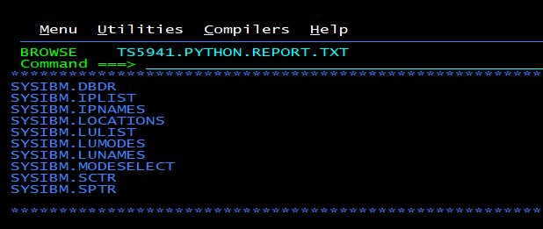
IBM Z Open Automation Utilities
import ibm_db
import sys
from zoautil_py import datasets
print(ibm_db.__version__)
conn=ibm_db.connect('','','')
print("Connected",conn)
datasetname = "TS5941.PYTHON.REPORT.TXT"
if datasets.exists(datasetname):
datasets.delete(datasetname)
datasets.create(datasetname, type="SEQ",
record_length=133, record_format="FB",
primary_space="10k")
content = ""
if conn:
sql = "SELECT * FROM SYSIBM.SYSTABLES …"
stmt = ibm_db.exec_immediate(conn, sql)
result = ibm_db.fetch_both(stmt)
while( result ):
content = content +
result[1].strip()+"."+result[0].strip() + "\n"
result = ibm_db.fetch_both(stmt)
ibm_db.close(conn)
datasets.write(datasetname,content=content)
Example: run query and write to sequential dataset

Slide 52
Interact with z/OS
import requests
url = 'https://rs01.rocketsoftware.com:11443/zosmf/restjobs/jobs?prefix=IZPS*&owner=*'
auth = requests.auth.HTTPBasicAuth('userid', 'password')
print(auth)
resp = requests.get(url,auth=auth,verify=False)
if resp.ok:
print("%8s %8s %8s %8s %8s" % \
("Jobname", "JobId", "Owner", "Status","Retcode"))
for j in resp.json():
print("%8s %8s %8s %8s %8s" % \
( j["jobname"], j["jobid"], j["owner"], j["status"], j["retcode"] ))
z/OSMF REST APIs
Also expensive to call
Will work on both z/OS and distributed

Slide 53
Interact with z/OS
import requests
url = 'https://rs01.rocketsoftware.com:11443/zosmf/restjobs/jobs?prefix=IZPS*&owner=*'
auth = requests.auth.HTTPBasicAuth('userid', 'password')
print(auth)
resp = requests.get(url,auth=auth,verify=False)
if resp.ok:
print("%8s %8s %8s %8s %8s" % \
("Jobname", "JobId", "Owner", "Status","Retcode"))
for j in resp.json():
print("%8s %8s %8s %8s %8s" % \
( j["jobname"], j["jobid"], j["owner"], j["status"], j["retcode"] ))
z/OSMF REST APIs
Also expensive to call
Will work on both z/OS and distributed
Jobname JobId Owner Status Retcode
IZPSRV STC01178 DOESTC OUTPUT CC 0000
IZPSRV STC04386 DOESTC OUTPUT CC 0000
IZPSRVP STC04120 DOESTC OUTPUT CC 0000
IZPSRVP STC04121 DOESTC OUTPUT CC 0000
IZPSRVP STC04113 DOESTC OUTPUT CC 0000
IZPSRVP STC04119 DOESTC OUTPUT CC 0000
IZPSRVP STC04112 DOESTC OUTPUT CC 0000
IZPSRVP STC04111 DOESTC OUTPUT CC 0000
IZPSRVP STC04110 DOESTC OUTPUT CC 0000
IZPSRV STC04387 DOESTC ACTIVE None
IZPSRVP STC04122 DOESTC ACTIVE None
IZPSRV2 STC07395 DOESTC ACTIVE None

Slide 54
Interact with z/OS
CFFI
  Create python wrapper over C libraries, e.g., “access()” to check if file exists

Slide 55
Conclusion
Python is popular
Python can talk to Db2 for z/OS
Python can run on z/OS (read: USS)
Python can run on z/OS and now also talk to Db2 for z/OS

Slide 56
Install on LPAR w/o internet access
Pip download ibm_db – on your laptop
Transfer to USS; unzip
cd python-ibmdb-v.r.m/IBM_DB/ibm_db
chtag –R –tc ISO8859-1 .
Pip install .

Slide 57
Troubleshooting (1)
“Exception” on connect without detailed error messages
Most likely an encoding error with the ODBC ini file
MUST BE encoded in IBM-1047
MUST BE tagged IBM-1047
“text” tag must be off
Check file contents, e.g., [ and ] (hex 0xAD and 0xBD)
Traceback (most recent call last):
File "simple-test.py", line 5, in <module>
conn=ibm_db.connect('','','')
Exception

Slide 58
import requests
import sys
import time
if len(sys.argv) < 3:
print("Usage: %s <userid> <password> " % (sys.argv[0]))
exit(-1)
userid=sys.argv[1]
password=sys.argv[2]
baseUrl='https://rs01.rocketsoftware.com:9944'
verify='/u/ts5941/cert/RS01.ROCKET.BASE64'
maxretry=10
loginbody = {
"userid": userid,
"password": password
}
vebody = {
"connection": "profile1",
"sql_text": "SELECT NAME, CREATOR, TSNAME, COLCOUNT, CARD, NPAGES FROM SYSIBM.SYSTABLES WHERE TSNAME = 'ANLSPC08';",
"schema": "TS5941",
"explain_schema": "TS5941"
}
# Generate JWT auth token
print("Logon TMS")
url = baseUrl + '/tuningservice/v1/auth/tokens'
resp = requests.post(url,json=loginbody,verify=verify)
print(resp)
token=resp.json()['token']
#print(token)
headers={'Authorization':'Bearer '+token}
#Submit Runstats advisor
print("Submit Runstats advisor")
url = baseUrl + '/tuningservice/v1/sa'
resp = requests.post(url,json=vebody,verify=verify,headers=headers)
print(resp)
#print(resp.json())
print(resp.json()['payload']['result'])
job_id=resp.json()['job_id']
#Check for VE job to complete
url = baseUrl + '/tuningservice/v1/jobs/' + job_id
retry=0
while True:
resp = requests.get(url,verify=verify,headers=headers)
status=resp.json()['payload']['result']['status']
print("Job ID %s status %s" % (job_id,status))
if status == 'COMPLETED':
break
if retry > maxretry:
print('Max retries reached')
sys.exit(-1)
time.sleep(5)
retry = retry + 1
#Retrieve results
print("Runstats advisor results")
url = baseUrl + '/tuningservice/v1/jobs/' + job_id + '/result'
resp = requests.get(url,verify=verify,headers=headers)
print(resp)
#print(resp.json())
for sa in resp.json()['payload']['result']:
print("Runstats recommended:\n %s" % (sa['runstats_recommended']))

