Slide 1
SQL Tuning that Still Works
Sheryl Larsen, BMC
Even with the Intelligence of Db2zAI
z/OS

Slide 2
First SQL Class Db2 V1
SELECT O.ORDERID, C.CUSTOMERID, B.BILL, SUM(B.AMOUNT) AS TOTAL
FROM ORDER O, CUSTOMER C, BILL B
WHERE B.DATE > ‘01-01-2017’
AND O.ODERID = C.ORDERID
AND C.CUSTOMERID = B.CUSTOMERID
GROUP BY O.ORDERID, C. CUSTOMERID, B.BILL
ORDER BY TOTAL DESC

Slide 3
1984
abs (Absolute) instruction
add (Add) or cax (Compute Address) instruction
addc or a (Add Carrying) instruction
adde or ae (Add Extended) instruction
addi (Add Immediate) or cal (Compute Address Lower) instruction
addic or ai (Add Immediate Carrying) instruction
addic. or ai. (Add Immediate Carrying and Record) instruction
addis or cau (Add Immediate Shifted) instruction
addme or ame (Add to Minus One Extended) instruction
addze or aze (Add to Zero Extended) instruction
and (AND) instruction
andc (AND with Complement) instruction
andi. or andil. (AND Immediate) instruction
andis. or andiu. (AND Immediate Shifted) instruction
b (Branch) instruction
bc (Branch Conditional) instruction
bcctr or bcc (Branch Conditional to Count Register) instruction
bclr or bcr (Branch Conditional Link Register) instruction
clcs (Cache Line Compute Size) instruction
clf (Cache Line Flush) instruction
cli (Cache Line Invalidate) instruction
cmp (Compare) instruction
cmpi (Compare Immediate) instruction
cmpl (Compare Logical) instruction
cmpli (Compare Logical Immediate) instruction
cntlzd (Count Leading Zeros Double Word) instruction
cntlzw or cntlz (Count Leading Zeros Word) instruction
crand (Condition Register AND) instruction
crandc (Condition Register AND with Complement) instruction
creqv (Condition Register Equivalent) instruction
crnand (Condition Register NAND) instruction
crnor (Condition Register NOR) instruction
cror (Condition Register OR) instruction
crorc (Condition Register OR with Complement) instruction
crxor (Condition Register XOR) instruction
dcbf (Data Cache Block Flush) instruction
dcbi (Data Cache Block Invalidate) instruction
dcbst (Data Cache Block Store) instruction
dcbt (Data Cache Block Touch) instruction
dcbtst (Data Cache Block Touch for Store) instruction
dcbz or dclz (Data Cache Block Set to Zero) instruction
dclst (Data Cache Line Store) instruction
div (Divide) instruction
divd (Divide Double Word) instruction
divdu (Divide Double Word Unsigned) instruction
divs (Divide Short) instruction
divw (Divide Word) instruction
divwu (Divide Word Unsigned) instruction
doz (Difference or Zero) instruction
dozi (Difference or Zero Immediate) instruction
eciwx (External Control In Word Indexed) instruction
ecowx (External Control Out Word Indexed) instruction
eieio (Enforce In-Order Execution of I/O) instruction
extsw (Extend Sign Word) instruction
eqv (Equivalent) instruction
extsb (Extend Sign Byte) instruction
extsh or exts (Extend Sign Halfword) instruction
fabs (Floating Absolute Value) instruction
fadd or fa (Floating Add) instruction
fcfid (Floating Convert from Integer Double Word) instruction
fcmpo (Floating Compare Ordered) instruction
fcmpu (Floating Compare Unordered) instruction
fctid (Floating Convert to Integer Double Word) instruction
fctidz (Floating Convert to Integer Double Word with Round toward Zero) instruction
fctiw or fcir (Floating Convert to Integer Word) instruction
fctiwz or fcirz (Floating Convert to Integer Word with Round to Zero) instruction
fdiv or fd (Floating Divide) instruction
fmadd or fma (Floating Multiply-Add) instruction
fmr (Floating Move Register) instruction
fmsub or fms (Floating Multiply-Subtract) instruction
fmul or fm (Floating Multiply) instruction
fnabs (Floating Negative Absolute Value) instruction
fneg (Floating Negate) instruction
fnmadd or fnma (Floating Negative Multiply-Add) instruction
fnmsub or fnms (Floating Negative Multiply-Subtract) instruction
fres (Floating Reciprocal Estimate Single) instruction
frsp (Floating Round to Single Precision) instruction
frsqrte (Floating Reciprocal Square Root Estimate) instruction
fsel (Floating-Point Select) instruction
fsqrt (Floating Square Root, Double-Precision) instruction
fsqrts (Floating Square Root Single) instruction
fsub or fs (Floating Subtract) instruction
icbi (Instruction Cache Block Invalidate) instruction
isync or ics (Instruction Synchronize) instruction
lbz (Load Byte and Zero) instruction
lbzu (Load Byte and Zero with Update) instruction
lbzux (Load Byte and Zero with Update Indexed) instruction
lbzx (Load Byte and Zero Indexed) instruction
ld (Load Doubleword) instruction
ldarx (Load Doubleword Reserve Indexed) instruction
ldu (Load Doubleword with Update) instruction
ldux (Load Doubleword with Update Indexed) instruction
ldx (Load Doubleword Indexed) instruction
lfd (Load Floating-Point Double) instruction
lfdu (Load Floating-Point Double with Update) instruction
lfdux (Load Floating-Point Double with Update Indexed) instruction
lfdx (Load Floating-Point Double-Indexed) instruction
lfq (Load Floating-Point Quad) instruction
lfqu (Load Floating-Point Quad with Update) instruction
lfqux (Load Floating-Point Quad with Update Indexed) instruction
lfqx (Load Floating-Point Quad Indexed) instruction
lfs (Load Floating-Point Single) instruction
lfsu (Load Floating-Point Single with Update) instruction
lfsux (Load Floating-Point Single with Update Indexed) instruction
lfsx (Load Floating-Point Single Indexed) instruction
lha (Load Half Algebraic) instruction
lhau (Load Half Algebraic with Update) instruction
lhaux (Load Half Algebraic with Update Indexed) instruction
lhax (Load Half Algebraic Indexed) instruction
lhbrx (Load Half Byte-Reverse Indexed) instruction
lhz (Load Half and Zero) instruction
lhzu (Load Half and Zero with Update) instruction
lhzux (Load Half and Zero with Update Indexed) instruction
lhzx (Load Half and Zero Indexed) instruction
lmw or lm (Load Multiple Word) instruction
lq (Load Quad Word) instruction
lscbx (Load String and Compare Byte Indexed) instruction
lswi or lsi (Load String Word Immediate) instruction
lswx or lsx (Load String Word Indexed) instruction
lwa (Load Word Algebraic) instruction
lwarx (Load Word and Reserve Indexed) instruction
lwaux (Load Word Algebraic with Update Indexed) instruction
lwax (Load Word Algebraic Indexed) instruction
lwbrx or lbrx (Load Word Byte-Reverse Indexed) instruction
lwz or l (Load Word and Zero) instruction
lwzu or lu (Load Word with Zero Update) instruction
lwzux or lux (Load Word and Zero with Update Indexed) instruction
lwzx or lx (Load Word and Zero Indexed) instruction
maskg (Mask Generate) instruction
maskir (Mask Insert from Register) instruction
mcrf (Move Condition Register Field) instruction
mcrfs (Move to Condition Register from FPSCR) instruction
mcrxr (Move to Condition Register from XER) instruction
mfcr (Move from Condition Register) instruction
mffs (Move from FPSCR) instruction
mfmsr (Move from Machine State Register) instruction
mfocrf (Move from One Condition Register Field) instruction
mfspr (Move from Special-Purpose Register) instruction
mfsr (Move from Segment Register) instruction
mfsri (Move from Segment Register Indirect) instruction
mfsrin (Move from Segment Register Indirect) instruction
mtcrf (Move to Condition Register Fields) instruction
mtfsb0 (Move to FPSCR Bit 0) instruction
mtfsb1 (Move to FPSCR Bit 1) instruction
mtfsf (Move to FPSCR Fields) instruction
mtfsfi (Move to FPSCR Field Immediate) instruction
mtocrf (Move to One Condition Register Field) instruction
mtspr (Move to Special-Purpose Register) instruction
mul (Multiply) instruction
mulhd (Multiply High Double Word) instruction
mulhdu (Multiply High Double Word Unsigned) instruction
mulhw (Multiply High Word) instruction
mulhwu (Multiply High Word Unsigned) instruction
mulld (Multiply Low Double Word) instruction
mulli or muli (Multiply Low Immediate) instruction
mullw or muls (Multiply Low Word) instruction
nabs (Negative Absolute) instruction
nand (NAND) instruction
neg (Negate) instruction
nor (NOR) instruction
or (OR) instruction
orc (OR with Complement) instruction
ori or oril (OR Immediate) instruction
oris or oriu (OR Immediate Shifted) instruction
popcntbd (Population Count Byte Doubleword) instruction
rac (Real Address Compute) instruction
rfi (Return from Interrupt) instruction
rfid (Return from Interrupt Double Word) instruction
rfsvc (Return from SVC) instruction
rldcl (Rotate Left Double Word then Clear Left) instruction
rldicl (Rotate Left Double Word Immediate then Clear Left) instruction
rldcr (Rotate Left Double Word then Clear Right) instruction
rldic (Rotate Left Double Word Immediate then Clear) instruction
rldicl (Rotate Left Double Word Immediate then Clear Left) instruction
rldicr (Rotate Left Double Word Immediate then Clear Right) instruction
rldimi (Rotate Left Double Word Immediate then Mask Insert) instruction
rlmi (Rotate Left Then Mask Insert) instruction
rlwimi or rlimi (Rotate Left Word Immediate Then Mask Insert) instruction
rlwinm or rlinm (Rotate Left Word Immediate Then AND with Mask) instruction
rlwnm or rlnm (Rotate Left Word Then AND with Mask) instruction
rrib (Rotate Right and Insert Bit) instruction
sc (System Call) instruction
scv (System Call Vectored) instruction
si (Subtract Immediate) instruction
si. (Subtract Immediate and Record) instruction
sld (Shift Left Double Word) instruction
sle (Shift Left Extended) instruction
sleq (Shift Left Extended with MQ) instruction
sliq (Shift Left Immediate with MQ) instruction
slliq (Shift Left Long Immediate with MQ) instruction
sllq (Shift Left Long with MQ) instruction
slq (Shift Left with MQ) instruction
slw or sl (Shift Left Word) instruction
srad (Shift Right Algebraic Double Word) instruction
sradi (Shift Right Algebraic Double Word Immediate) instruction
sraiq (Shift Right Algebraic Immediate with MQ) instruction
sraq (Shift Right Algebraic with MQ) instruction
sraw or sra (Shift Right Algebraic Word) instruction
srawi or srai (Shift Right Algebraic Word Immediate) instruction
srd (Shift Right Double Word) instruction
sre (Shift Right Extended) instruction
srea (Shift Right Extended Algebraic) instruction
sreq (Shift Right Extended with MQ) instruction
sriq (Shift Right Immediate with MQ) instruction
srliq (Shift Right Long Immediate with MQ) instruction
srlq (Shift Right Long with MQ) instruction
srq (Shift Right with MQ) instruction
srw or sr (Shift Right Word) instruction
stb (Store Byte) instruction
stbu (Store Byte with Update) instruction
stbux (Store Byte with Update Indexed) instruction
stbx (Store Byte Indexed) instruction
std (Store Double Word) instruction
stdcx. (Store Double Word Conditional Indexed) instruction
stdu (Store Double Word with Update) instruction
stdux (Store Double Word with Update Indexed) instruction
stdx (Store Double Word Indexed) instruction
stfd (Store Floating-Point Double) instruction
stfdu (Store Floating-Point Double with Update) instruction
stfdux (Store Floating-Point Double with Update Indexed) instruction
stfdx (Store Floating-Point Double Indexed) instruction
stfiwx (Store Floating-Point as Integer Word indexed)
stfq (Store Floating-Point Quad) instruction
stfqu (Store Floating-Point Quad with Update) instruction
stfqux (Store Floating-Point Quad with Update Indexed) instruction
stfqx (Store Floating-Point Quad Indexed) instruction
stfs (Store Floating-Point Single) instruction
stfsu (Store Floating-Point Single with Update) instruction
stfsux (Store Floating-Point Single with Update Indexed) instruction
stfsx (Store Floating-Point Single Indexed) instruction
sth (Store Half) instruction
sthbrx (Store Half Byte-Reverse Indexed) instruction
sthu (Store Half with Update) instruction
sthux (Store Half with Update Indexed) instruction
sthx (Store Half Indexed) instruction
stmw or stm (Store Multiple Word) instruction
stq (Store Quad Word) instruction
stswi or stsi (Store String Word Immediate) instruction
stswx or stsx (Store String Word Indexed) instruction
stw or st (Store) instruction
stwbrx or stbrx (Store Word Byte-Reverse Indexed) instruction
stwcx. (Store Word Conditional Indexed) instruction
stwu or stu (Store Word with Update) instruction
stwux or stux (Store Word with Update Indexed) instruction
stwx or stx (Store Word Indexed) instruction
subf (Subtract From) instruction
subfc or sf (Subtract from Carrying) instruction
subfe or sfe (Subtract from Extended) instruction
subfic or sfi (Subtract from Immediate Carrying) instruction
subfme or sfme (Subtract from Minus One Extended) instruction
subfze or sfze (Subtract from Zero Extended) instruction
svc (Supervisor Call) instruction
sync (Synchronize) or dcs (Data Cache Synchronize) instruction
td (Trap Double Word) instruction
tdi (Trap Double Word Immediate) instruction
tlbie or tlbi (Translation Look-Aside Buffer Invalidate Entry) instruction
tlbld (Load Data TLB Entry) instruction
tlbli (Load Instruction TLB Entry) instruction
tlbli instruction function
tlbsync (Translation Look-Aside Buffer Synchronize) instruction
tw or t (Trap Word) instruction
twi or ti (Trap Word Immediate) instruction
xor (XOR) instruction
xori or xoril (XOR Immediate) instruction
xoris or xoriu (XOR Immediate Shift) instruction
No internet
No cell phone
No laptop
No ear buds
No email
No …….

Slide 4
Fast Forward
1984
Inner and Outer Joins, Table Expressions, Subqueries, GROUP BY, ORDER BY, Complex Correlation, Global Temporary Tables, CASE, 100+ Built-in Functions including SQL/XML, Limited Fetch, Insensitive Scroll Cursors, UNION Everywhere, MIN/MAX Single Index, Self Referencing Updates with Subqueries, Sort Avoidance for ORDER BY, and Row Expressions, 2M Statement Length, GROUP BY Expression, Sequences, Scalar Fullselect, Materialized Query Tables, Common Table Expressions, Recursive SQL, CURRENT PACKAGE PATH, VOLATILE Tables, Star Join, Sparse Index, Qualified Column names, Multiple DISTINCT clauses, ON COMMIT DROP, Transparent ROWID Column, Call from trigger, statement isolation, FOR READ ONLY KEEP UPDATE LOCKS, SET CURRENT SCHEMA, Client special registers, long SQL object names, SELECT from INSERT, UPDATE or DELETE, INSTEAD OF TRIGGER, SQL PL in routines, BIGINT, file reference variables, XML, FETCH FIRST & ORDER BY in subselect & fullselect, caseless comparisons, INTERSECT, EXCEPT, MERGE not logged tables, OmniFind, spatial, range partitions, data compression, DECFLOAT, optimistic locking, ROLE, TRUNCATE, index & XML compression, created temps, inline LOB, administrative privileges, implicit cast, increased timestamp precision, currently committed, moving sum & average, index include columns, row and column access controls, time travel query, GROUPING SETS, ROLLUP, CUBE, global variables, Text Search functions, accelerated tables, DROP COLUMN, array data type, XML enhancements, moving SUM/AVG, …
1989
35
Y
E
A
R
S
2003
2010
2015
2019

Slide 5
Cost based Optimizer figures out how to get the data
Optimizer
Optimizer

Slide 6
DB2 Engine Components
SQL Execution
Result
SQL
Work
Files
Catalog
Optimizer
Catalog
Stage 2
Meta Data
RID
Pool
Directory
Directory
Stage 1
Dynamic Statement
Cache
Access Plans
Buffer Pool
Top of Index tree cache
Buffer Manager
Data
Index
RIDs
6

Slide 7
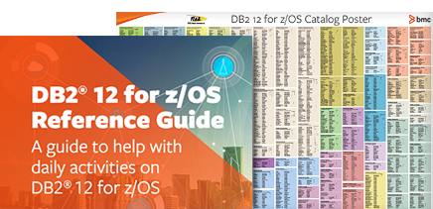
Meta Data – Everything known about each object
SQL
Stored in the Catalog
Work
Files
Catalog
Catalog
Optimizer
Catalog
Catalog
Meta Data
Meta Data
Meta Data
Buffer Pool
Optimizer reads all information needed to calculate cost $
Data

Slide 8
Static SQL Access Plans Stored in Directory
SQL
Work
Files
Catalog
Catalog
Optimizer
Catalog
Catalog
Meta Data
BINDing is what puts the access path in the Directory
Meta Data
Meta Data
Directory
Buffer Pool
Access Plans
Data

Slide 9
Dynamic SQL is stored in the Dynamic Statement Cache
SQL
Optimizer
Directory
Dynamic Statement
Cache
Access Plans
Access Plans
BIND done automatically at run time

Slide 10
Execution time is when the Access Plan is given to the Buffer Manager
Buffer Pool
Access Plans
Buffer Manager
Data
Index

Slide 11
Buffer Pool stores data in memory
SQL
Work
Files
Catalog
Directory
Buffer Pool
Buffer Pool
Buffer Manager
Data
Index

Slide 12
Stage 1 & 2 filter the data
SQL
Work
Files
Catalog
Stage 2
Directory
Stage 1
Buffer Pool
Buffer Pool
Buffer Manager
Data
Index

Slide 13
Indexable Stage 1 Predicates
Stage 1 Predicates
Indexable = The predicate is applied to the root page of the chosen index. When the optimizer chooses to use a predicate in the probe of the index, the condition is named Matching (matching the index). This is the first point that filtering is possible in DB2.
Index Screening = The Stage 1 predicate is a candidate for filtering on the index leaf pages. This is the second point of filtering in DB2. If partitioned filters limiting partitions are also applied
Data Screening = The Stage 1 predicate is a candidate for filtering on the data pages. This is the third point of filtering in DB2.
Stage 2 = The predicate is not listed as Stage 1 and will be applied on the remaining qualifying pages from Stage 1. This is the fourth and final point of filtering in DB2.

Slide 14
Four Points of Filtering
WHERE C.LAST_NM LIKE ?
C.TOKEN_NR =
B.TOKEN_NR
AND C.ROLE_CD > ?
AND CASE C.SEX WHEN ‘X’ THEN ? END) = ‘ABCDE’
Indexable Stage 1 Probe
Stage 1 Index Filtering
Stage 1 Data Filtering
Stage 2
1
TOKEN_NR. ROLE_CD
C1.C2.C3
2
3
4
14
Notes:
Indexable Stage 1 Probe - Only 28 for DB2 12, can be applied at this point. The ones that will be applied are dependent on which index was chosen, the conditions on the columns belonging in the index, and the sequence of those columns. If the first column of the index is used in a “=“ predicate, the column is used to navigate the tree along with the next column (2 matching). If the next column is used in a “=“ predicate, the column is used to navigate the tree along with the previous two columns (3 matching). If the next column is not an “=“ predicate, the matching stops with this condition (4 matching) unless it is nonindexable or Stage 2 (3 matching). If the first column is not and “=“ predicate, only the first column is used to navigate the tree (1 matching). The number of matching columns usually = one more than the last matching condition. Data types are required to match until V8.
2. Stage 1 Index Filtering - If there is no predicate involving the first column of the index, tree navigation is not allowed (0 matching). Any Stage 1 predicate (all 40) can be applied on the leaf page. This point of filtering is called index screening. Stage 2 conditions can also be applied after the Stage 1 conditions are applied (if this is index only access and the Stage 2 column is included in the index - like COL9 above). Data types are required to match until V8.
3. Stage 1 Data Filtering - Any Stage 1 condition that has not been applied in the index entries is applied when the data page is accessed (because all columns live there). Data types are required to match until V8.
4. Stage 2 Data Filtering - Any condition that is not Stage 1 will be applied at this point (an infinite number of possible predicates). This filtering is still better than program filtering which occurs after each element on the result row is transferred to the calling program (one at a time). Any data type mismatches were filtered here until V8.

Slide 15
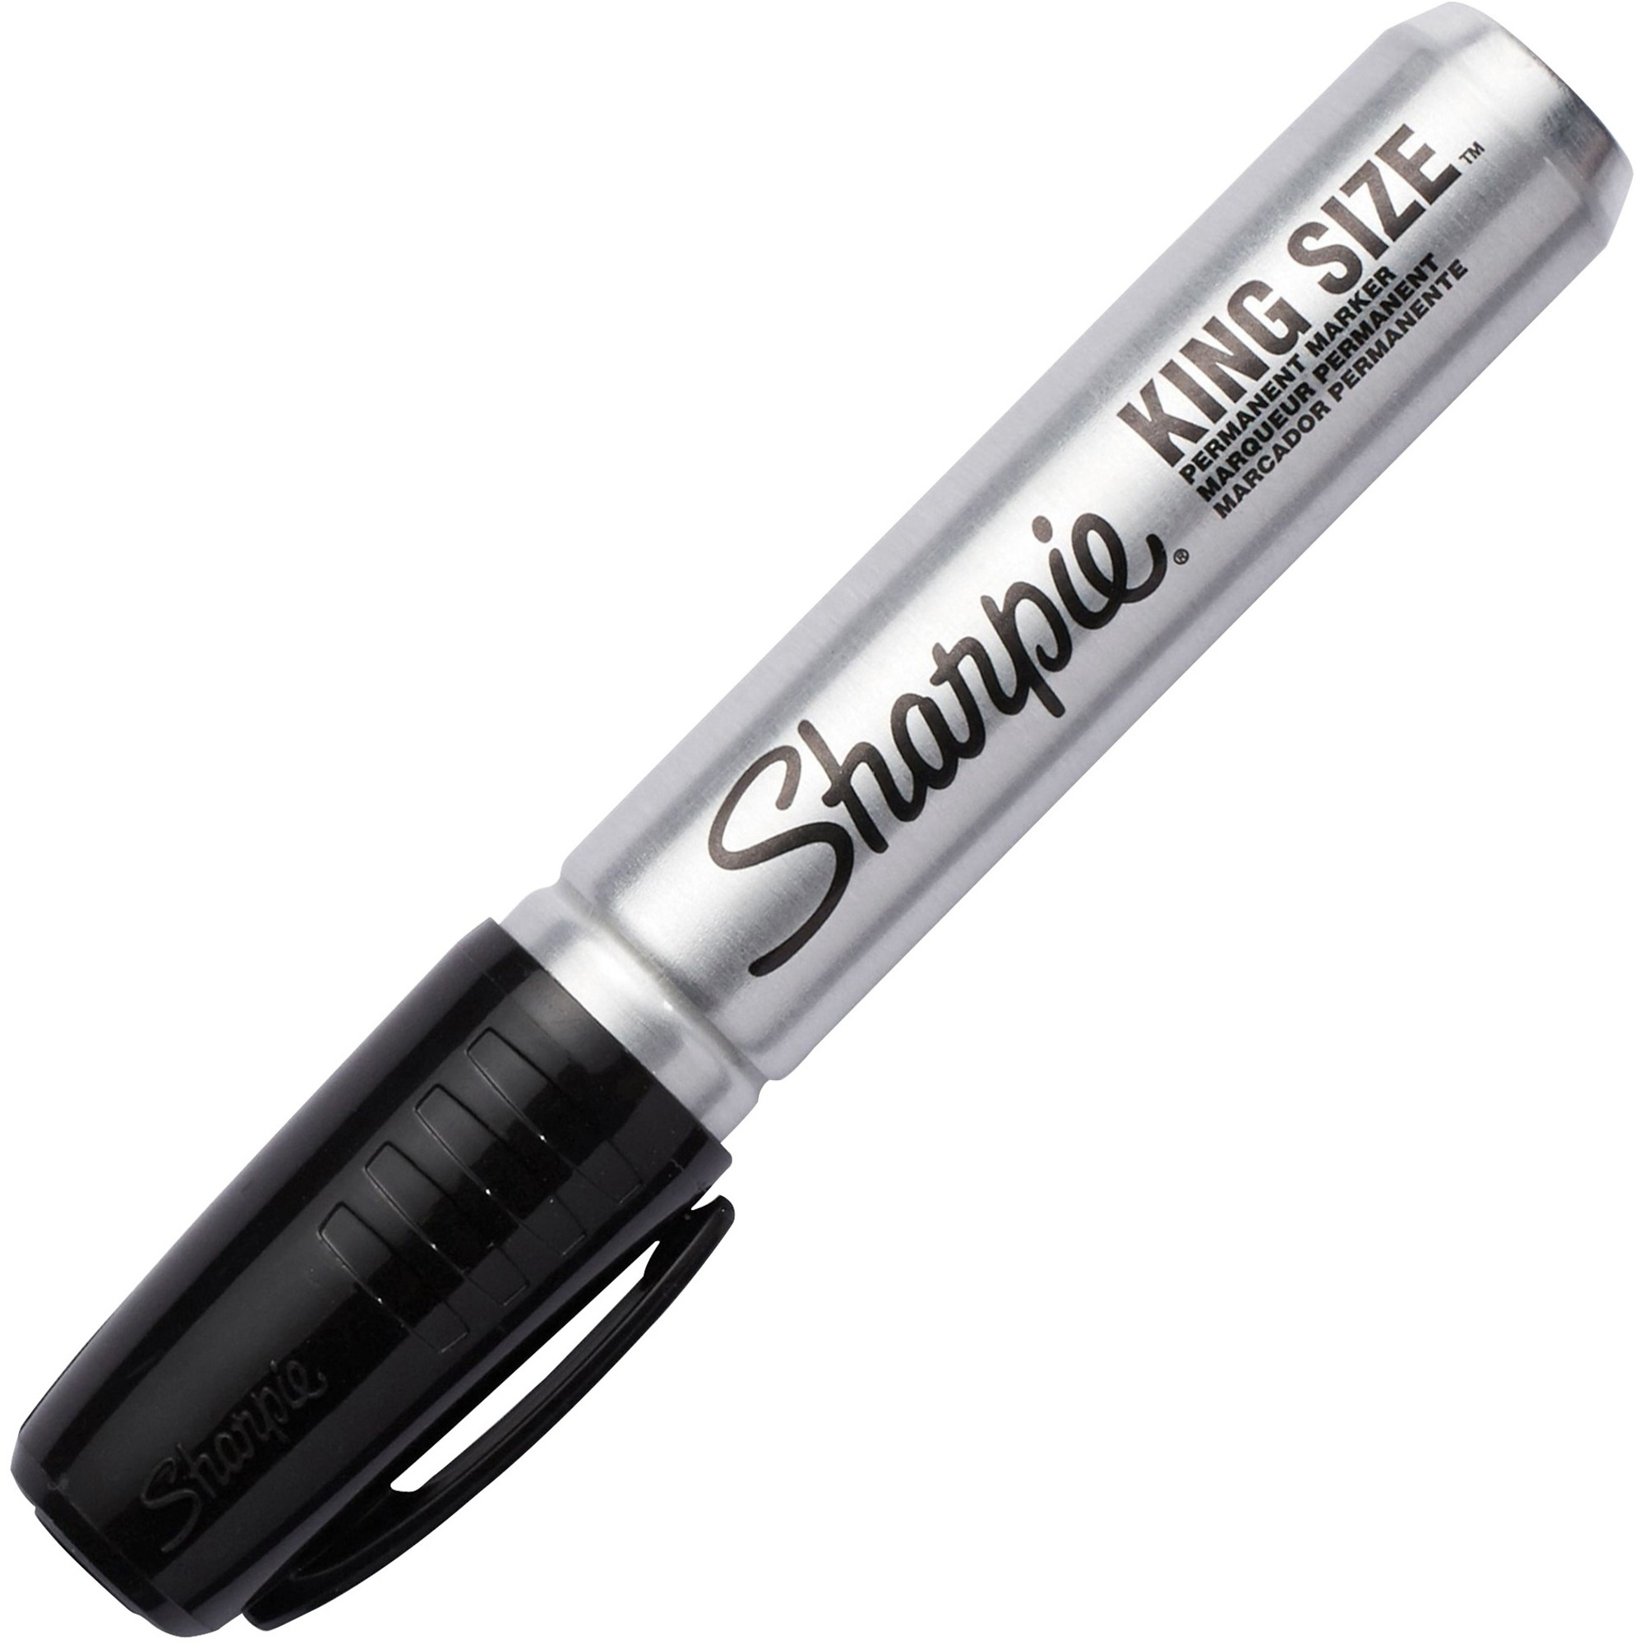
Filtering – z/OS
Work
Files
Stage 2
4K
WHERE C1 = ?
AND C2 > ?
AND C3 < ?
AND C4 = ?
AND C5 BETWEEN ? AND ?
AND C6 IN (?, ?, ?)
ORDER BY C1, C2, C3
Stage 1
Buffer Pool
c1c2c3
Buffer Manager
c4c5c6
Data
Index
15

Slide 16
If a Sort is needed for ORDER BY/GROUP BY
SQL
Work Files are filled with the remaining result data and sorted … sometimes
Work
Files
Catalog
Stage 2
Directory
Stage 1
Buffer Pool
Buffer Pool
Buffer Manager
Data
Index

Slide 17
The Result is brought back in memory
Data is sent to calling program
Result
SQL
Work
Files
Catalog
Stage 2
Directory
Stage 1
Buffer Pool
Buffer Pool
Buffer Manager
Data
Index

Slide 18
Calling Source may be Remote
Result
SQL
Network
Work
Files
Catalog
Optimizer
Catalog
Stage 2
Meta Data
RID
Pool
Directory
Directory
Stage 1
Dynamic Statement
Cache
Access Plans
Buffer Pool
Top of Index tree cache
Buffer Manager
Data
Index
RIDs
18

Slide 19
What Could Go Wrong?
Bad SQL goes in
Result
SQL
Work
Files
Catalog
Optimizer
Catalog
Stage 2
Sort Work blows up!
Meta Data
RID
Pool
Directory
Directory
Stage 1
Dynamic Statement
Cache
Access Plans
Buffer Pool
Bad Access Plans get chose
Buffer Manager
Data
Index
Data gets disorganized
RIDs
Wrong Indexes
19

Slide 20
Agenda
Review of what Db2zAI can and cannot do
How to change the optimizers mind Case Studies Using a Proven Method
Extreme Tuning
How to put a query on a diet
What other query attributes are red flags to optimal performance?

Slide 21
The Db2 Optimizer How Does it Decide so Fast?
Good Input
35 years of catalog statistics refinement
Ability to use some real time information
Ability to refine scope of data collection - STATSFEEDBACK
Cost-based Smarts
35 years of algorithm refinement
Creates a cost model for every query
Defaults are used when query values are unknown
How close does the optimizer get with ‘?’ or ‘:hv’?

Slide 22
The Trillions of Optimizer Cost-based Results
Good for Everybody
Great for a Few

Slide 23
Default Statistics
WHERE >?
WHERE BETWEEN ? AND ?
How Close to Reality?
Notes:
Open ended ranges, ‘>’ etc. and closed ended ranges, BETWEEN or LIKE
Use machine learning to improve the quality and effectiveness of inputs to the optimizer cost model

Slide 24
There Are Many Ways to Get to Your Data
Matching Index
Nested Loop Join
Multiple Index Access
IN(Iist)
Merge Join
NonMatching Index
Limited Partition Scan
NPI
Direct Row
One Fetch
Pair Wise Star Join
Hybrid Join Type C
Table Scan
Merge Scan Join
Table Scan
Table Scan
List Prefect
Hybrid Join Type N
Sparse Index
Notes:
Discuss their comdplexity – perhaps joke with them that it wasn’t always like this. It’s getting worse!

Slide 25
The Answer: Personalize Your Optimizer
Technology needed:
Learns patterns from workload data collected in your unique operating environment
Uses derived insight in determining optimal access paths for SQL statements
Built on top of the IBM Machine Learning for z/OS (MLz) stack
Leverages MLz services without requiring data scientist support –
Db2 generates model training data, deploys and monitors and retrains models via MLz services
• Db2ZAI product ID: 5698-CGN
Notes:
And here’s a reminder of what we’ve delivered in the last 18 months…
Walk through them all and pick a few to highlight.
Remind them that like you said in the morning, we are also investing and looking at areas to accelerate our AMI roadmap. Giving you more exciting capabilities to sell and a stronger buying vision to paint for your clients.

Slide 26
VDS
Notes:
Virtual Data Scientist! Has the data, knows which algorithm to use, learns from modeling and scoring, provides solutions, and cleans up after itself.

Slide 27
IDEA: Augment the Db2 Z Optimizer with AI/Machine Learning!
Correct estimates used for :hv and ?
Add OPIMIZE FOR n Rows when # of rows fetched is learned
Examine Sort behavior to optimize memory usage
Optimize parallelism in packages using history
The Db2 Z Optimization Team Took Action: https://www.ibm.com/support/knowledgecenter/en/SSGKMA_1.2.0.2/src/ai/ai_home.html
IBM Db2® AI for z/OS® aka Db2zAI

Slide 28
VDS – Virtual Data Scientist
Has the data
Catalog statistics
Deep execution statistics
History
Knows which algorithm to use
Classification for known patterns
Linear Regression for Date/Time sequencing
Models for random behavior
Learns from modeling and scoring
Watches 100 executions
Provides solutions
A list of ready packages
Db2ZAI SQL Performance dashboard
Cleans up after itself
Keep models current and removes old behavior
Notes:
A type of supervised machine learning: classification
Another type of supervised machine learning: regression

Slide 29
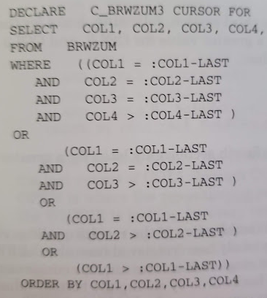
Fill in Unknown Values - :hv or ?
Learn from the workload …..
Customized Filter Factors
For STATIC use REBIND
For DYNAMIC uses PREPARE
WHERE (LASTNAME, FIRSTNAME) > (‘SMITH’, ‘JOHN’)
WHERE (C1,C2,C3,C4) > (:C1L, :C2L, :C3L, :C4L)
Applies To
Any query with :hv or ?
PACKAGE Selection Screen
INCLUDE/EXCLUDE
Recommended List

Slide 30
Predict # of Rows Qualifying
OPTIMIZE FOR n ROWS
Input
Track last fetched + SQLCODE
Repeat 100 times
Take AVG #
Applies To
Queries qualifying many rows,
But retrieving only a few

Slide 31
Optimize Sort Tree Usage and Memory
SQL with DISTINCT
ORDER BY or FETCH FIRST large rows
Any > 4K row sort
Sort Tree
Sort Tree
Sort Tree
Sort Tree
Fill in Tree
Swap
Swap
Swap
If just REORG’d
No Swap

Slide 32
Optimize Parallelism in non-OLTP Queries
DEGREE = ‘ANY’
DSNZPARM CDDSSRDEF = ‘ANY’
Input
Transactions > 120ms
Never < 10ms
Output
Reduced ELAPSED
Reduced CPU

Slide 33
Db2ZAI: Augment the Db2 Z Optimizer with AI/Machine Learning!
Fill in “unknown” values in queries – Use Classification, Linear Regression and Model random behavior to correct estimates
Predict number of rows processed and add OPIMIZE FOR n = Optimal Rows
Examine Sort behavior to optimize memory usage
Optimize Parallelism in non-OLTP packages
Notes:
Db2ZAI

Slide 34
SQL Review Checklist
Examine Program logic
Examine FROM clause
Verify Join conditions
Promote Stage 2’s and Stage 1 NOTs
Prune SELECT lists
Verify local filtering sequence
Analyze Access Paths
Tune if necessary
Notes:
1. Examine Program logic – check for program filtering and joining. Move work into the query.
2. Examine FROM clause – order of tables insignificant unless > 9 table joins. List preferred join sequence for this and OUTER JOINs
3. Verify Join conditions – make sure every table is hooked up correctly to avoid cartesian joins
4. Promote Stage 2’s/Residuals and Stage 1’s if possible – promotions can change access paths
5. Verify data type matches – mismatched numeric and date/time will cause delays in filtering and alter the access path
6. Prune SELECT lists – remove columns with values determined to be static by WHERE clause filtering. Remove columns used in the ORDER BY or GROUP BY sequencing but not needed for the display.
7. Verify local filtering sequence – If host variables are used, add parenthesis to override the predetermined filtering sequence when necessary. This reduces the CPU required to disqualify rows
8. Analyze Access Paths – Only check the access path of the FINAL query, after query rewrite, bound with production statistics in a subsystem that resembles the production thresholds as closely as possible.
9. Tune if necessary – A topic for today!

Slide 35
SQL Tuning Examples
WHERE S.SALES_ID > 44
AND S.MNGR = :hv-mngr
AND S.REGION BETWEEN :hvlo AND :hvhi CONCAT ‘ ‘
No Operation
SELECT S.QTY_SOLD, S.ITEM_NO
, S.ITEM_NAME
FROM SALE S
WHERE S.ITEM_NO > :hv
ORDER BY ITEM_NO
FETCH FIRST 22 ROWS ONLY
Limited Fetch

Slide 36
All the Possible Access Paths
One Fetch
IN(list) Index Access
One Fetch
IN(list) Index Access
Limited Partition Scan Using
Non-partitioning index (NPI)
Nested Loop
Nested Loop
Matching Index Access
Limited Partition Scan
Using Partitioning Index
Matching Index Access
Sparse Index Access
Limited Partition Scan
With Partitioning Index
Hybrid
Hybrid Join: Type C or Type N
NonMatching
Index Access
Limited Partition Scan
Using Data Partitioned Secondary Index (DPSI
Limited Partition Scan
With NPI
Merge Scan
NonMatching
Index Access
Star Join: Cartesian or Pair-wise
Db2 11
List Prefetch
Table Scan
Star
List Prefetch
Merge Scan
Makes Dynamic
Multiple Index Access
Partitioned Table Scan
Direct Row
Multiple Index Access
(Bold names use an Index)

Slide 37
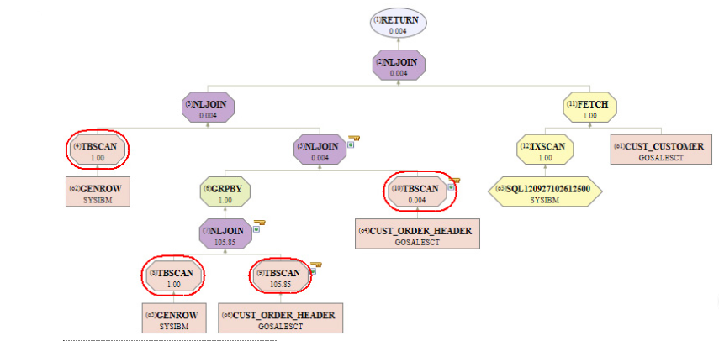
Access Path Analysis
The larger the graph and the more rows involved, the more costly it is.

Slide 38
Tuning SQL
FIND ALL Expensive Queries
---------+---------+---
PROGNAME PROCSU
---------+---------+---
EXPNPROG 121,059,664 EXPNPROG 21,059,664
ONESECPG 79,664
SUBSECPG 9,664
CHEEPPRG 64
FREEPROG 4

Slide 39
PROCSU is Too Expensive to Calculate!
2,147,483,647
2,147,483,647
2,147,483,647
2,147,483,647
2,147,483,647
2,147,483,647
2,147,483,647
2,147,483,647
2,147,483,647
2,147,483,647
2,147,483,647
2,147,483,647
2,147,483,647
2,147,483,647
2,147,483,647
2,147,483,647
2,147,483,647
2,147,483,647
2,147,483,647
2,147,483,647

Slide 40
Tuning Techniques to Apply When Necessary
Learn Traditional Tuning Techniques
OPTIMIZE FOR n ROWS
No Ops
Index & MQT Design
Experiment with Extreme Tuning Techniques
DISTINCT Table Expressions
Odd/old Techniques
Anti-Joins
Manual Query Rewrite

Slide 41
OPTIMIZE FOR n ROWS FETCH FIRST n ROWS
Both clauses influence the Optimizer
To encourage index access and nested loop join
To discourage list prefetch, sequential prefetch, and access paths with Rid processing
Use FETCH n = total rows required for set
Use OPTIMIZE n = number of rows to send across network for distributed applications
Works at the statement level

Slide 42
Fetch First Example
Query #1
Optimizer choose List Prefetch Index Access + sort for ORDER BY for 50,000 rows
All qualifying rows processed (materialized) before first row returned = .81 sec
<.1sec response time required
SELECT S.QTY_SOLD
, S.ITEM_NO
, S.ITEM_NAME
FROM SALE S
WHERE S.ITEM_NO > :hv
ORDER BY ITEM_NO
Query #1 Tuned
Optimizer now chooses Matching Index Access (first probe .004 sec)
No materialization
Cursor closed after 22 items displayed (22 * .0008 repetitive access)
.004 + .017 = .021 sec
SELECT S.QTY_SOLD, S.ITEM_NO
, S.ITEM_NAME
FROM SALE S
WHERE S.ITEM_NO > :hv
ORDER BY ITEM_NO
FETCH FIRST 22 ROWS ONLY

Slide 43
No Operation (No Op)
+0, CONCAT ‘ ‘ also –0, *1, /1
Place no op next to predicate
Use as many as needed
Discourages index access, however, preserves Stage 1
Can Alter table join sequence
Can fine tune a given access path
Can request a table scan
Works at the predicate level
Does not Benefit DB2 on Linux, UNIX or Windows

Slide 44
No Op Example CONCAT ‘ ‘
SALES_ID.MNGR.REGION Index
MNGR Index
REGION Index
SELECT S.QTY_SOLD
, S.ITEM_NO
, S.ITEM_NAME
FROM SALE S
WHERE S.SALES_ID > 44
AND S.MNGR = :hv-mngr
AND S.REGION BETWEEN :hvlo AND :hvhi
ORDER BY S.REGION
Optimizer chooses Multiple Index Access
The table contains 100,000 rows and there are only 6 regions
Region range qualifies 2/3 of table
<.1sec response time required
No Op allows Multiple Index Access to continue on first 2 indexes
Two Matching index accesses, two small Rid sorts, & Rid intersection
…….
FROM SALE S
WHERE S.SALES_ID > 44
AND S.MNGR = :hv-mngr
AND S.REGION BETWEEN :hvlo AND :hvhi CONCAT ‘ ‘
ORDER BY R.REGION

Slide 45
No Op Example - Scan
SALES_ID.MNGR.REGION Index
MNGR Index
REGION Index
SELECT S.QTY_SOLD
, S.ITEM_NO
, S.ITEM_NAME
FROM SALE S
WHERE S.SALES_ID > 44 +0
AND S.MNGR = :hv-mngr CONCAT ‘ ‘
AND S.REGION BETWEEN :hvlo AND :hvhi CONCAT ‘ ‘
ORDER BY S.REGION
FOR FETCH ONLY
WITH UR
If you know the predicates do very little filtering, force a table scan
Use a No Op on every predicate
This forces a table scan
FOR FETCH ONLY encourages parallelism
WITH UR for read only tables to reduce CPU
Should this be
Documented?

Slide 46
DISTINCT Table Expressions
Table expressions with DISTINCT
FROM (SELECT DISTINCT COL1 FROM T1 …..) AS STEP1 JOIN T2 ON … JOIN T3 ON ….
Used for forcing creation of logical set of data
No physical materialization if an index satisfies DISTINCT
Can encourage sequential detection
Can encourage a Merge Scan join
STEP1 Logical
Buffer Pool
Index
STEP1 Physical
Work
File
Data

Slide 47
DISTINCT Table Expressions Example
SELECT Columns FROM TABX, TABY, (SELECT DISTINCT COL1, COL2 ….. FROM BIG_TABLE Z WHERE local conditions) AS BIGZ WHERE join conditions
Optimizer is forced to analyze the table expression prior to joining TABX & TABY
Notes:
BIG_TABLE is accessed first
Possibly results in materialized and sorted BIGZ workfile if DISTINCT cannot be satisfied using an index
Great for tuning dynamic queries!

Slide 48
Typical Join Problem
SELECT COL1, COL2 ….. FROM ADDR, NAME, TAB3, TAB4, TAB5, TAB6, TAB7 WHERE join conditions
AND TAB6.CODE = :hv
Result is only 1,000 rows
ADDR and NAME first two tables in join
Index scan on TAB6 table
Not good because zero filter
Cardinality 1

Slide 49
Tuning Technique
Keeps large tables joined last
SELECT COL1, COL2 ….. FROM ADDR, NAME,
(SELECT DISTINCT columns
FROM TAB3, TAB4, TAB5, TAB6, TAB7
WHERE join conditions
AND (TAB6.CODE = :hv OR 0 = 1)) AS TEMP
WHERE join conditions
Gets rid of Index Scan

Slide 50
Using Common Table Expressions
WITH TEMP AS(SELECT DISTINCT columns
FROM TAB3, TAB4, TAB5, TAB6, TAB7
WHERE 4 join conditions
AND (TAB6.CODE = :hv OR 0 = 1)
SELECT COL1, COL2 ….. FROM ADDR, NAME, TEMP
WHERE join 2 conditions

Slide 51
Put a Query on a Diet
For Extreme Cases
(used on all platforms)

Slide 52
A Typical Data Warehouse Query
Initial cost of 16 million timerons
WOULD NOT FINISH!
A DISTINCT table expression and GROUP BY
Initial join involved all columns and all rows
The very wide and very deep set was dragged through many more query steps
Notes:
As queries get more complex, intra query optimization becomes necessary. Cross queryblock knowledge can greatly assist the optimizer in query rewrite. Right now this is a manual rewrite process. One example is a statement that contained multiple UNION ALL subselects with the initial subselect involving and join requesting most rows all columns. This very wide and very deep set was dragged through many query steps.

Slide 53
Before and After
SELECT Lots of Columns
FROM
(SELECT Lots of Columns
FROM
(SELECT
FROM
INNER JOIN
INNER JOIN
INNER JOIN
(SELECT
FROM
INNER JOIN
SELECT
FROM
LEFT JOIN
(SELECT DISTINCT
FROM
LEFT JOIN
SELECT
FROM
LEFT JOIN
(SELECT FROM
LEFT JOIN
(SELECT
FROM
)
GROUP BY
))
GROUP BY
)))
))
Notes:
The outermost query block, the last step, requested a GROUP BY. This query would not even finish and the timeron value was over 16 million. To manually rewrite this query, the largest block was analyzed for the columns required for GROUP BY, and remaining LEFT JOINs. The initial SELECT list for that really wide table expression was then manually pruned down to SELECT only critical columns, but all rows. This essentially put the subselect on a diet so that the next 5 join steps were much narrower. The final step was then rewritten to join back to the tables to get the remaining SELECT list columns. This did increase the number of times that main set was accessed but the savings from the wide joins more than offset the cost.
Further analysis was done on the GROUP BY columns. It was determined that the only columns needed in the GROUP BY calculation were from the main set. The GROUP BY operation was moved from the outer most step and pushed into the first table expression. This greatly reduced the cost of the GROUP BY operation since it did not involve many columns.

Slide 54
Tuning Technique
Extreme Cross Query Block Optimization
Identify and pre-qualify the core set of data and only select the keys early on
Once all the steps are complete, go back and get the remaining columns
Referred to as “Group By Push Down” and “put your query on a diet”
Keeping it thin through the DB2 engine
Brought cost down to 270,000 timerons
Query now finishes in 4 minutes!
Notes:
The query now finishes and the timerons were reduced to .27 million. This technique of keeping the query thin through the DB2 engine has to be accomplished through manual query rewrite for now. Start by identifying the core set of data and only select the keys and grouping columns early on. Once all the step are complete, go back and get the remaining columns.

Slide 55
What other query attributes are red flags to optimal performance?
What ever Tony said!

Slide 56
SQL Tuning Confidence Level
0% -------------------------------------------------------------------------------------------------------- 100%

Slide 57
Speaker: Sheryl Larsen
Company: BMC
Email Address: sheryl_Larsen@bmc.com
Don’t forget to fill out a session evaluation!
Notes:
Sheryl M. Larsen is the Worldwide Db2 Z Solutions Ambassador at BMC. Previously she worked for IBM, Sheryl M. Larsen, Inc., and Platinum Technology (now Broadcom). She is known for her extensive expertise in SQL Tuning and has performed detailed Db2 Performance Health Checks for many Fortune 500 clients. Sheryl has over 30 years’ experience in Db2, has published many articles, white papers and co-authored a book, Db2 Answers, Osborne-McGraw-Hill, 1999. Currently she is the President of the Midwest Db2 User Group, an IBM Z Champion, and a member of the Northern Illinois University Computer Science Alumni Council.

