Slide 1
IDUG
The International Db2 User Group
IDUG RUG Committee

Slide 2
Agenda
IDUG Mission
What IDUG offers
RUG Committee

Slide 3
What is IDUG? www.idug.org
IDUG’s Mission Statement: The International Db2 Users Group (IDUG®) is an independent, not-for-profit, user-run organization whose mission is to support and strengthen the information services community by providing the highest quality education and services designed to promote the effective utilization of Db2.

Slide 4
Who is IDUG for?
Developers
Database Administrators
System Programmers
Security Engineers
IT Professionals
Data Architects/Engineers
Data Scientists/Analysts
IT Architects

Slide 5
Why IDUG?
Established over 30 years that provides “first class” technical education
Global, leading organisation that unites Db2 professionals
Members benefit from leading educational offerings, a network of experts available to share knowledge and answer questions,
Library of content on a wide range of topics.
Offer events all around the world including North America, Latin America, EMEA, Australia, Asia and expanding rapidly
Offer complimentary Db2 Certification at conferences
Supports local Db2 User Groups (RUGs)
Social networking communities for “like-minded” individuals

Slide 8
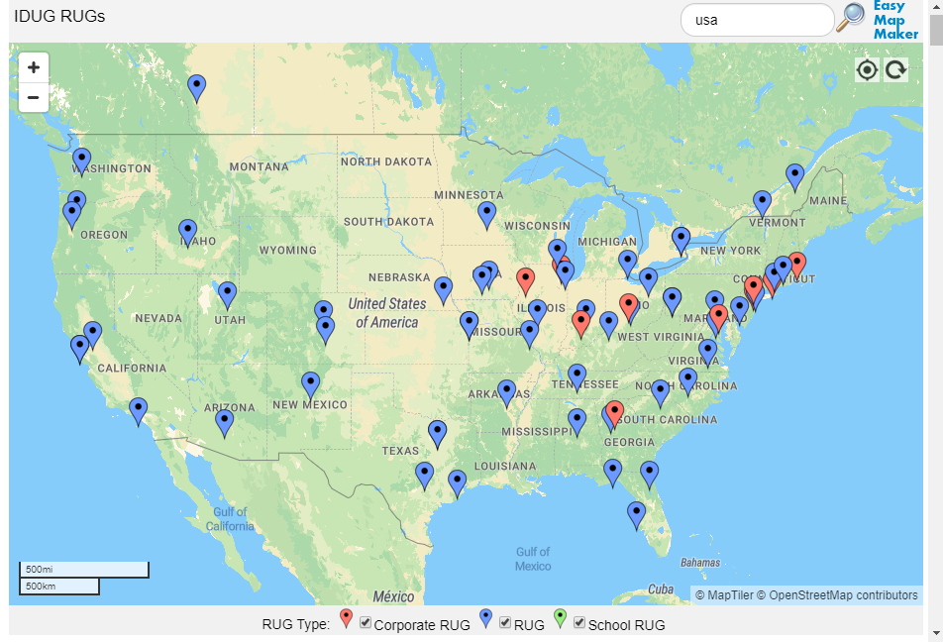
Benefits for Db2 User Groups

Slide 9
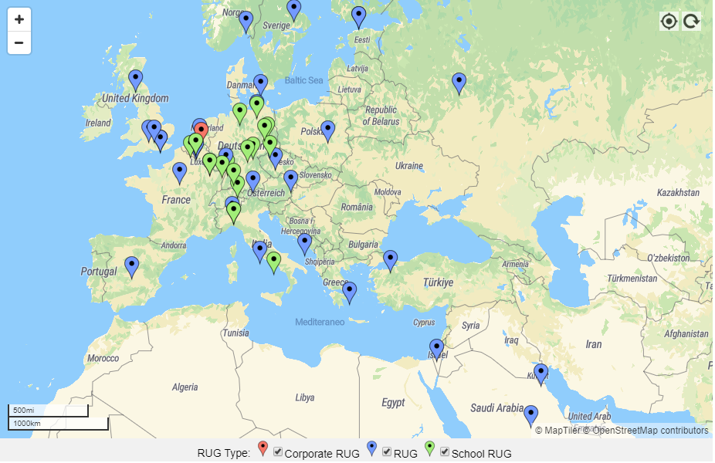
Benefits for Db2 User Groups

Slide 10
IDUG RUG Committee
For the initial years of the International DB2 Users Group (IDUG) organization, Regional User Group (RUG) support was at the Conference Planning Committee (CPC) level only and was not a coordinated effort across the organization. Accordingly, Db2 RUGs developed on their own as autonomous entities with little if any ties to IDUG
With the concentrated effort to focus more on strategy and less on operational, the Board of Directors approved the formation of an IDUG RUG Committee with a designated Chair in October 2020 as part of the Db2 in the Community strategic initiative

Slide 11
IDUG RUG Committee Organization IDUG RUG Committee Organization
IDUG RUG Committee Chair
Željen Stanić
IDUG RUG Committee Regional Members
North America Dustin Ratliff , Chris Muncan
EMEA Jan Tielemans, Mirna Kos
Latin America Javier Estrada Benavides
Asia open
Australia/New Zealand open
BoD Liaison
Mateja Jankovič
Vendor (BoD) Liaisons
IBM Jim Reed
BMC William Moran
Broadcom Stuart McIrvine

Slide 12
Activities till now
•MIDWEST (15.9.2020) |  |  |  |  |  | 65 | z/OS | Adobe Connect
•MIDWEST (16.9.2020) |  |  |  |  |  | 42 | LUW | Adobe Connect
•SQLAdria (25.11.-26.11.2020) |  |  |  |  |  | 89 | z/OS | MS Teams
•SQLAdria (27.11.2020) |  |  |  |  |  | 31 | LUW | MS Teams
•Wisconsin, St. Louis, Minnesota Twin Cities, Midwest (1.12.2020) |  |  |  |  |  | 67 | z/OS | G2M
•Wisconsin, St. Louis, Minnesota Twin Cities, Midwest (2.12.2020) |  |  |  |  |  | 30 | LUW | G2M
•SDUG (20.01.2021) |  |  |  |  |  | 27 | z/OS | G2M
•BELUX (25.02.2021) |  |  |  |  |  | 51 | z/OS | G2M
•MIDWEST (02.03.2021) |  |  |  |  |  | 110 | z/OS | G2M
•MIDWEST (03.03.2021) |  |  |  |  |  | 20 | LUW | G2M
•BELUX (20.03.2021) |  |  |  |  |  | 44 | z/OS | G2M
•Central Canada DUG (12.04.2021) |  |  |  |  |  | 85 |  | Adobe Connect
•Central Canada DUG (13.04.2021) |  |  |  |  |  | 39 |  | Adobe Connect
 |  |  |  |  | Total: | 700 | attendees

Slide 13
Activities till now – IDUG Db2 Latest News & Updates in 2022!

Slide 14
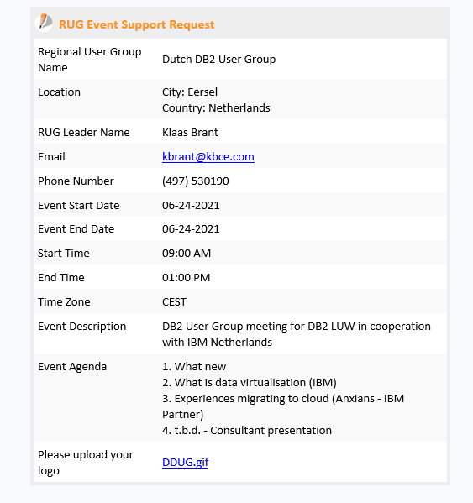
Activities till now – it works !
Created form for RUG support :
https://form.jotform.com/idug/rug-event-support-request
info published on Slack (db2rugleaders)
Request received: 17.5.2021

Slide 15
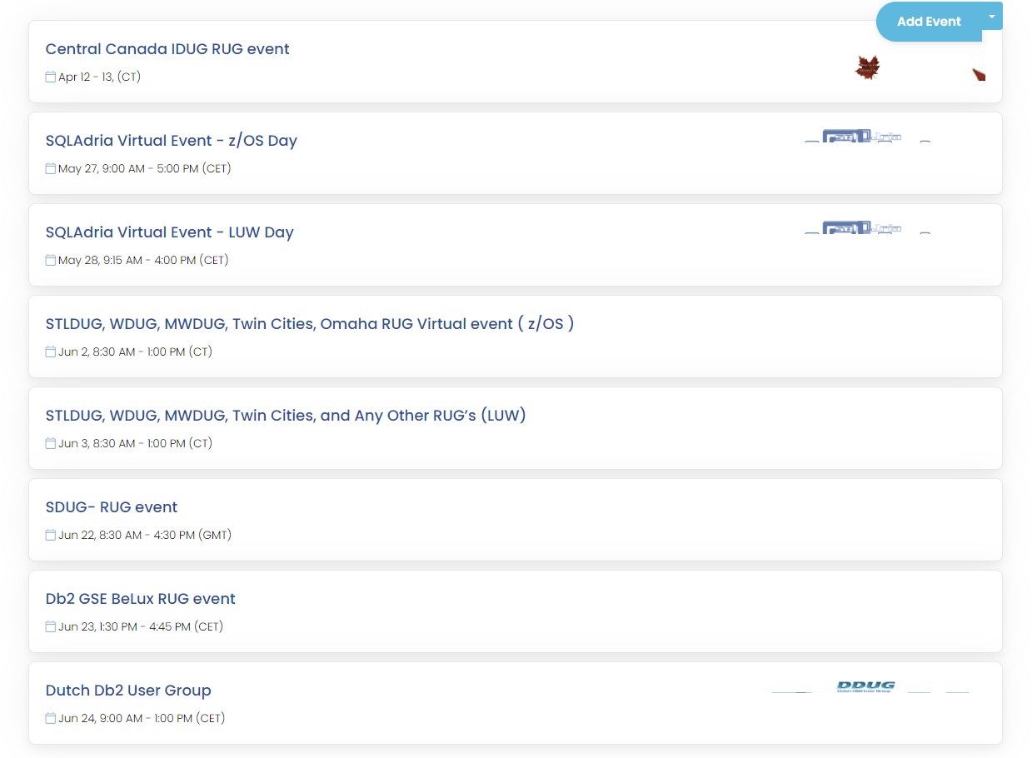
Activities till now

Slide 16
Benefits for Db2 User Groups
IBM Liaison supports your group
Vendor support
Common RUG calendar
Possibility to have a speaker from Content Committee ( “Fun with SQL” dojo,…)
IDUG can organize a booth in the Expo available to RUGs who are interested in marketing their groups to IDUG attendees.(in-person event)
Options for using IDUG virtual platform to organize virtual RUG events – (Adobe Connect, GoToMeeting,…)
More information / suggestions - email rugs@idug.org

Slide 17
Q & A

Slide 18
IDUG RUG Committee
Email: rugs@idug.org
RUG meeting

